Slide 1
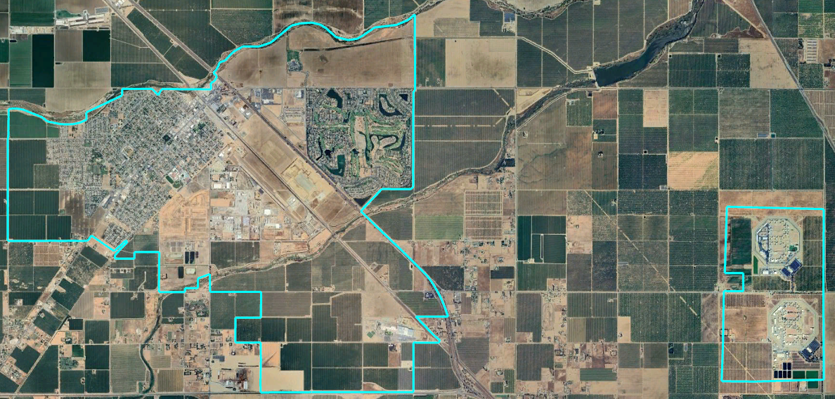
City of Chowchilla
Introduction to Districting
Dr. Jeff Tilton, Senior Consultant
National Demographics Corporation

Slide 2
Election Systems
“At Large”
“From District” or “Residence” Districts
“By District”
The California Voting Rights Act was written to specifically encourage by-district elections.

Slide 3
California Voting Rights Act (CVRA)
Under the Federal Voting Rights Act (passed in 1965), a jurisdiction must fail 4 factual tests before it is in violation of the law.
The California VRA makes it significantly easier for plaintiffs to force jurisdictions into “by-district” election systems by eliminating two of the US Supreme Court Gingles tests:
  Can the protected class constitute the majority of a district?
  Does the protected class vote as a bloc?
  Do the voters who are not in the protected class vote in a bloc to defeat the preferred candidates of the protected class?
  Do the “totality of circumstances” indicate race is a factor in elections?
Liability is now determined only by the presence of racially polarized voting and dilution of the protected class’s voting strength

Slide 4
CVRA Impact
Switched (or in the process of switching) as a result of CVRA:
  At least 323 school districts
  46 Community College Districts
  198 cities
  1 County Board of Supervisors
  Over 75 special districts
Cases so far:
  Palmdale, Santa Clara and Santa Monica went to trial on the merits. Palmdale and Santa Clara lost. Santa Monica is awaiting a decision.
  Modesto and Palmdale each spent about $1.8 million on their defense (in addition to the attorney fee awards in those cases).
  Santa Monica has spent an estimated $7 million so far. Plaintiffs in Santa Monica requested $22 million in legal fees after the original trial.
Sample settlements:
  Palmdale: $4.7 million
  Modesto: $3 million
  Highland: $1.3 million
  Anaheim: $1.1 million
  Whittier: $1 million
  Santa Barbara: $600,000
  Tulare Hospital: $500,000
  Camarillo: $233,000
  Compton Unified: $200,000
  Madera Unified: about $170,000
  Hanford Joint Union Schools: $118,000
  Merced City: $42,000
An estimated $16 million in total settlements and court awards so far.
April 9, 2024

Slide 5
Districting Process
Step | Description
Two Initial Hearings April 9 & April 23 | Held prior to release of draft maps Education and to solicit input on the composition of districts
Release draft maps May 7 | Maps must be posted at least 7 days prior to 3rd hearing
Two hearings on draft maps May 14 & May 28 | Two meetings to discuss and revise the draft maps and to discuss the election sequence
Map adoption June 11 | Map adopted via Ordinance. Final map must be posted at least 7 days prior to adoption

Slide 6
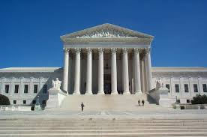
Districting Rules and Goals
1. Federal Laws
2. California Criteria
California Prohibition
Equal Population
Federal Voting Rights Act
No Racial Gerrymandering
In prioritized order:
Geographically contiguous
Undivided neighborhoods and “communities of interest”
(Socio-economic geographic areas that should be kept together)
Easily identifiable boundaries
Compact
(Do not bypass one group of people to get to a more distant group of people)
“Shall not adopt election district boundaries for the purpose of favoring or discriminating against an incumbent, political candidate, or political party.”
Other Traditional
Districting Principles
Future population growth

Slide 7
Demographic Summary
With 5 Council Districts, each must contain about 2,685 people.
April 9, 2024

Slide 8
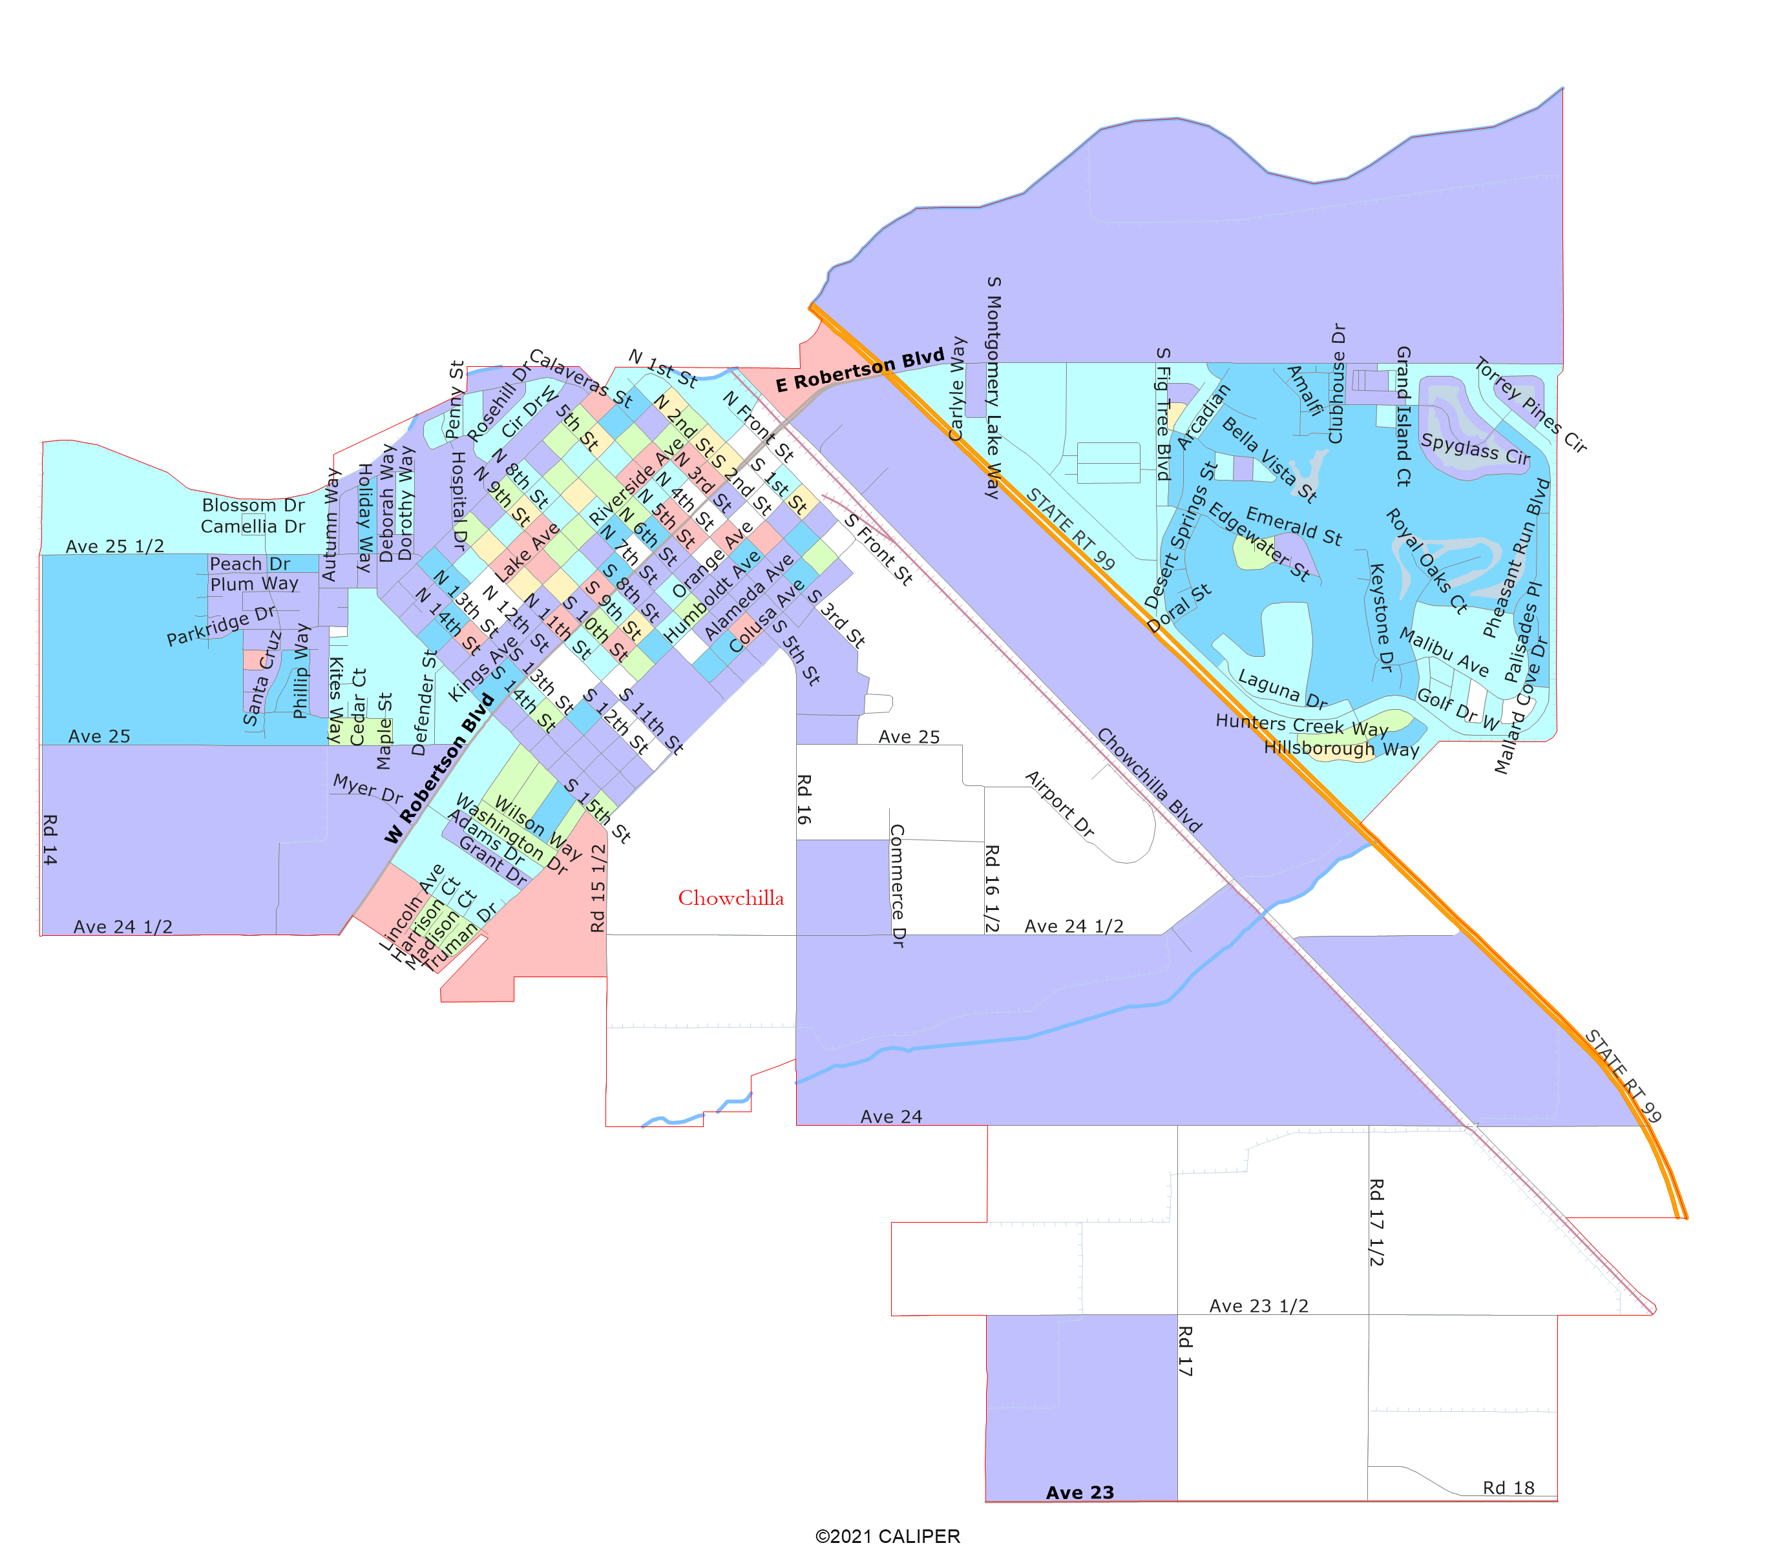
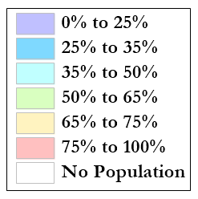
Latino CVAP
Latinos are a majority of CVAP in most of the city blocks west of the railroad and north of Ave 24 ½.

Slide 9
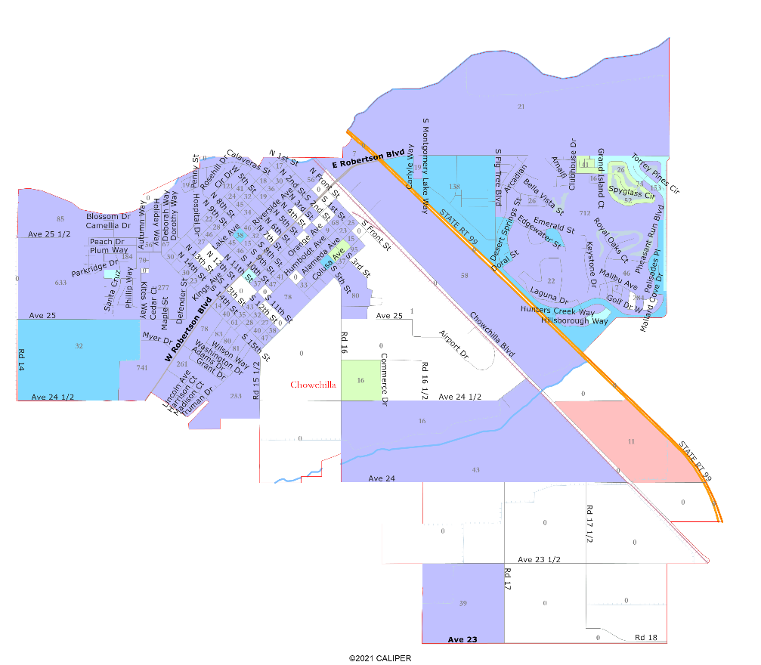
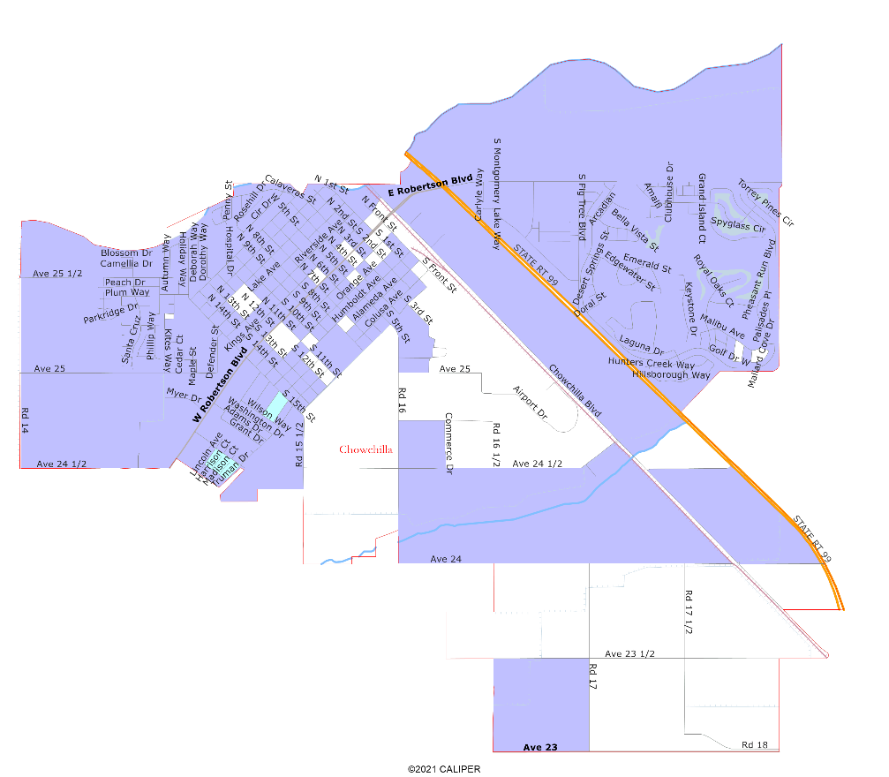
African-American and
Asian-American CVAP
African-Americans are not geographically concentrated in the City.
Asian-Americans are geographically concentrated only around the golf course in the northeast.

Slide 10

Defining Neighborhoods
How do you describe or name the area where you live?
What are its geographic boundaries?
What other neighborhoods are there?
Examples of physical features defining a neighborhood boundary:
Natural neighborhood dividing lines, such as highway or major roads, rivers, canals and/or hills
Areas around parks or schools
School attendance boundaries
Other neighborhood landmarks
April 9, 2024

Slide 11
Defining Communities of Interest
California Elections Code Section 21130(c)(2):
  A “community of interest” is a population that shares common social or economic interests that should be included within a single district for purposes of its effective and fair representation.
  The shared interests may include (but are not limited to):
  Shared public policy concerns such as education, public safety, public health, environment, housing, transportation, and access to social services. cultural districts;
  Shared socioeconomic characteristics;
  Similar voter registration rates and participation rates; and /or
  Shared histories.
Definitions of Communities of Interest may not include relationships with political parties, incumbents, or political candidates.

Slide 12





Your Turn
What area do you consider your neighborhood?
What are your “communities of interest”?
For each answer, please provide:
  Geographic boundaries
  The history or defining shared characteristic of the area
In the absence of public testimony, planning records and other similar documents may provide definition.
Any other questions about the process, criteria, maps, or any other part of this process?

Slide 13
Share Your Thoughts
Website
cityofchowchilla.org
Phone
559.665.8615 x102
Email
jmcclendon@cityofchowchilla.org

