Slide 1
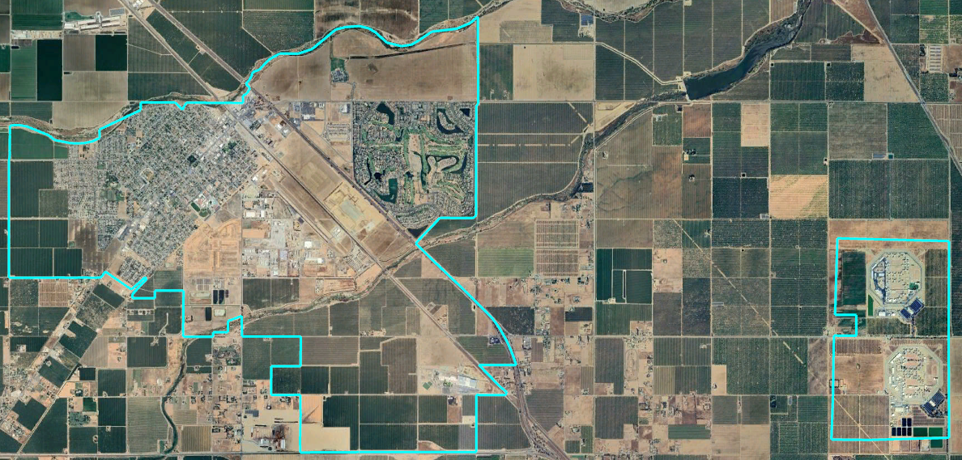
City of Chowchilla
Community Forum
Dr. Jeff Tilton, Senior Consultant
National Demographics Corporation

Slide 2
Districting Process
Step | Description
Two Initial Hearings April 9 & April 23 | Held prior to release of draft maps Education and to solicit input on the composition of districts
Release draft maps May 7 | Maps must be posted at least 7 days prior to 3rd hearing
Two hearings on draft maps May 14 & May 28 | Two meetings to discuss and revise the draft maps and to discuss the election sequence
Community Forum May 18 | Learn more about districting in Chowchilla Review draft maps
Map adoption June 11 | Map adopted via Ordinance. Final map must be posted at least 7 days prior to adoption

Slide 3
California Voting Rights Act (CVRA)
Under the Federal Voting Rights Act (passed in 1965), a jurisdiction must fail 4 factual tests before it is in violation of the law.
The California VRA makes it significantly easier for plaintiffs to force jurisdictions into “by-district” election systems by eliminating two of the US Supreme Court Gingles tests:
  Can the protected class constitute the majority of a district?
  Does the protected class vote as a bloc?
  Do the voters who are not in the protected class vote in a bloc to defeat the preferred candidates of the protected class?
  Do the “totality of circumstances” indicate race is a factor in elections?
Liability is now determined only by the presence of racially polarized voting and dilution of the protected class’s voting strength

Slide 4
CVRA Impact
Switched (or in the process of switching) as a result of CVRA:
  At least 323 school districts
  46 Community College Districts
  198 cities
  1 County Board of Supervisors
  Over 75 special districts
Cases so far:
  Palmdale, Santa Clara and Santa Monica went to trial on the merits. Palmdale and Santa Clara lost. Santa Monica is awaiting a decision.
  Modesto and Palmdale each spent about $1.8 million on their defense (in addition to the attorney fee awards in those cases).
  Santa Monica has spent an estimated $7 million so far. Plaintiffs in Santa Monica requested $22 million in legal fees after the original trial.
Sample settlements:
  Palmdale: $4.7 million
  Modesto: $3 million
  Highland: $1.3 million
  Anaheim: $1.1 million
  Whittier: $1 million
  Santa Barbara: $600,000
  Tulare Hospital: $500,000
  Camarillo: $233,000
  Compton Unified: $200,000
  Madera Unified: about $170,000
  Hanford Joint Union Schools: $118,000
  Merced City: $42,000
An estimated $16 million in total settlements and court awards so far.
May 18, 2024

Slide 5
Demographic Summary
May 18, 2024

Slide 6
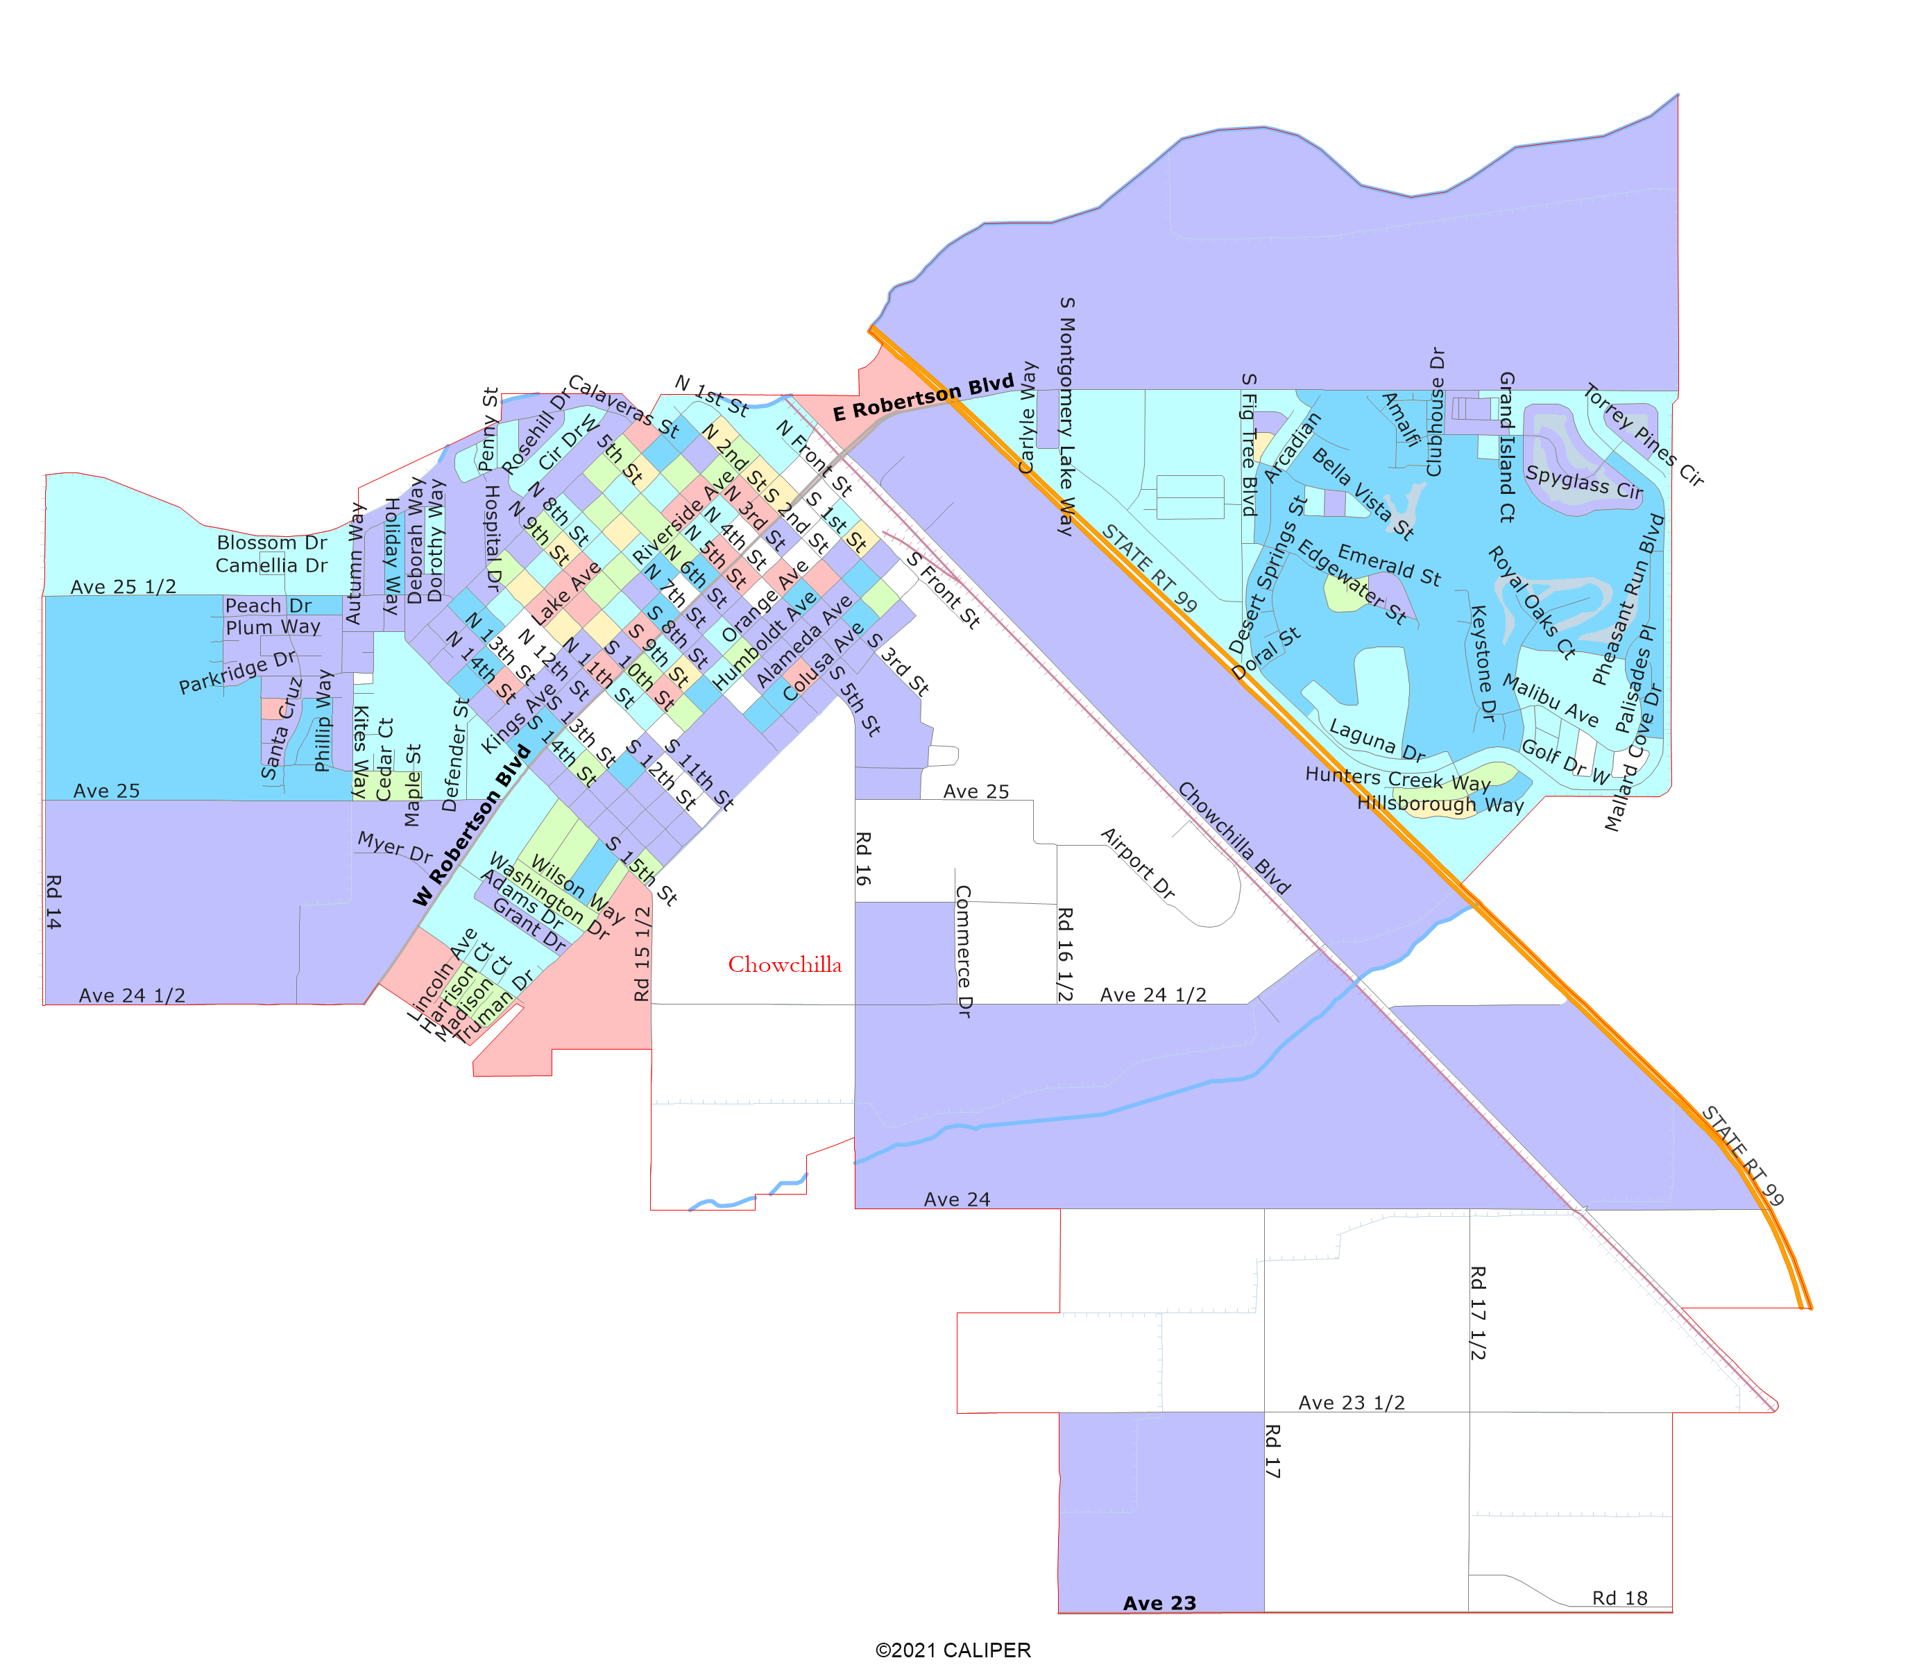
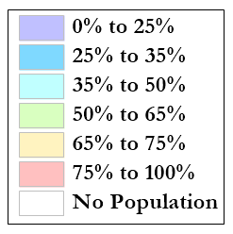
Latino CVAP
Latinos are a majority of CVAP in most of the city blocks west of the railroad and north of Ave 24 ½.

Slide 7
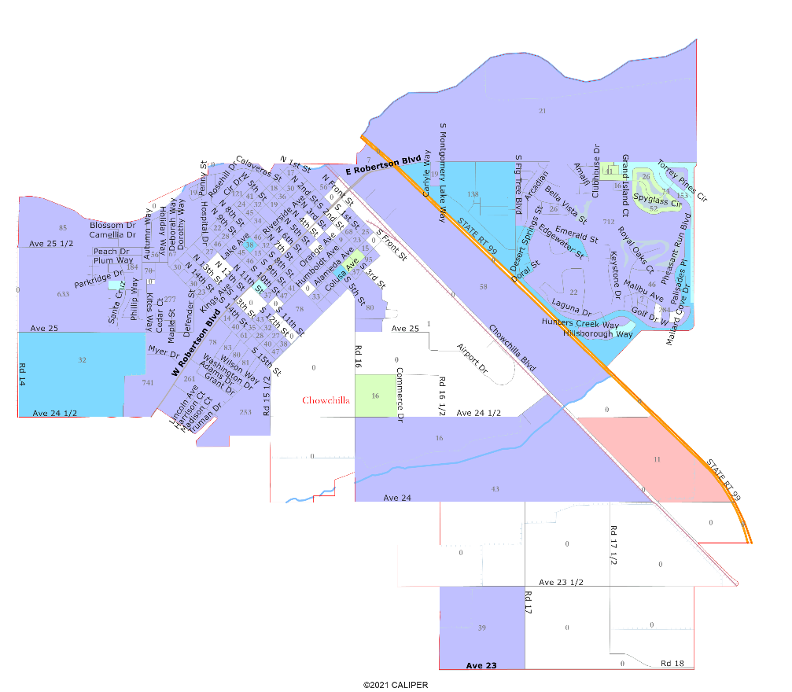
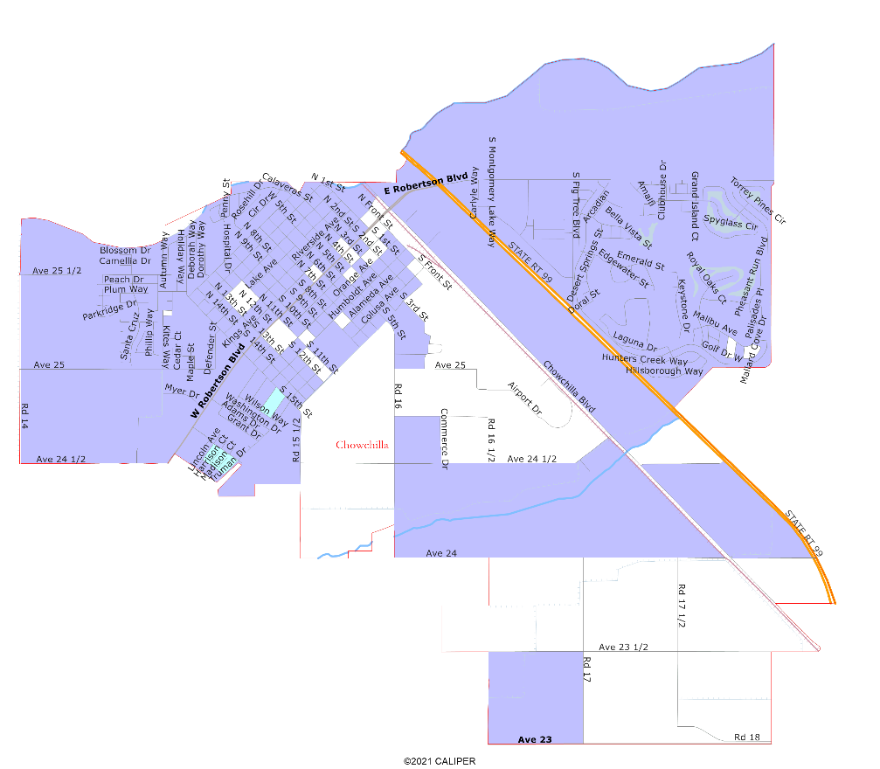
African-American and
Asian-American CVAP
African-Americans are not geographically concentrated in the City.
Asian-Americans are geographically concentrated only around the golf course in the northeast.

Slide 8
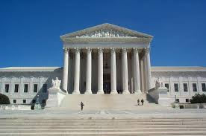
Districting Rules and Goals
1. Federal Laws
2. California Criteria
California Prohibition
Equal Population
Federal Voting Rights Act
No Racial Gerrymandering
In prioritized order:
Geographically contiguous
Undivided neighborhoods and “communities of interest”
(Socio-economic geographic areas that should be kept together)
Easily identifiable boundaries
Compact
(Do not bypass one group of people to get to a more distant group of people)
“Shall not adopt election district boundaries for the purpose of favoring or discriminating against an incumbent, political candidate, or political party.”
Other Traditional
Districting Principles
Future population growth

Slide 9
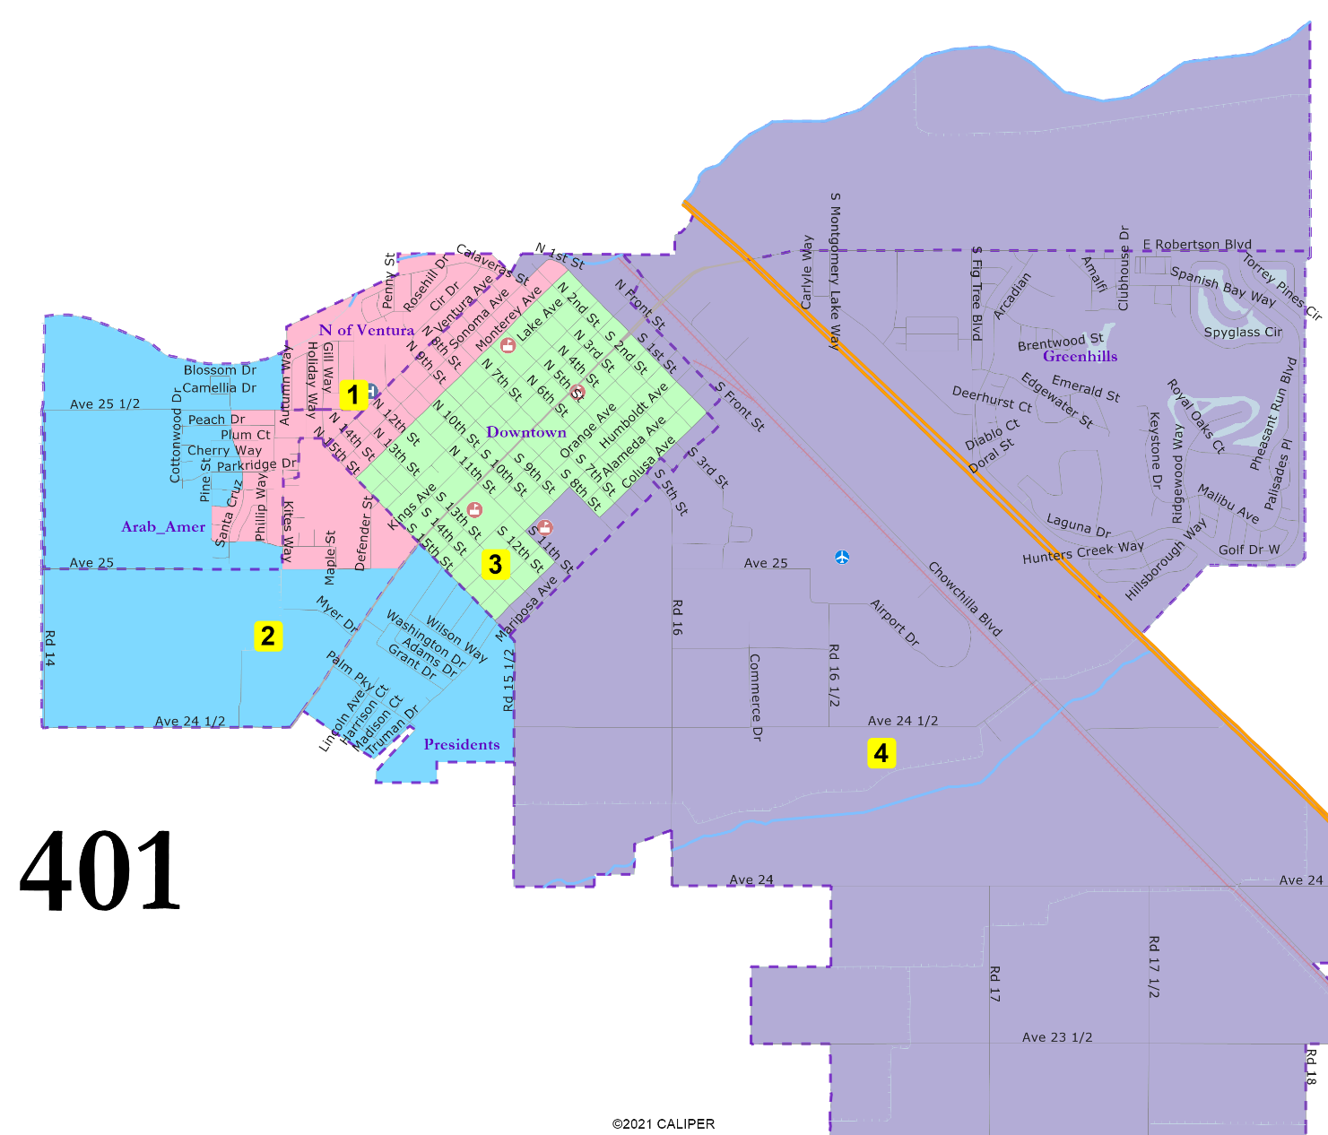
401: 4 districts, elective mayor
“President” Streets united.
North of Ventura united.
D3 entirely in Downtown.
Greenhills united.
May 18, 2024

Slide 10
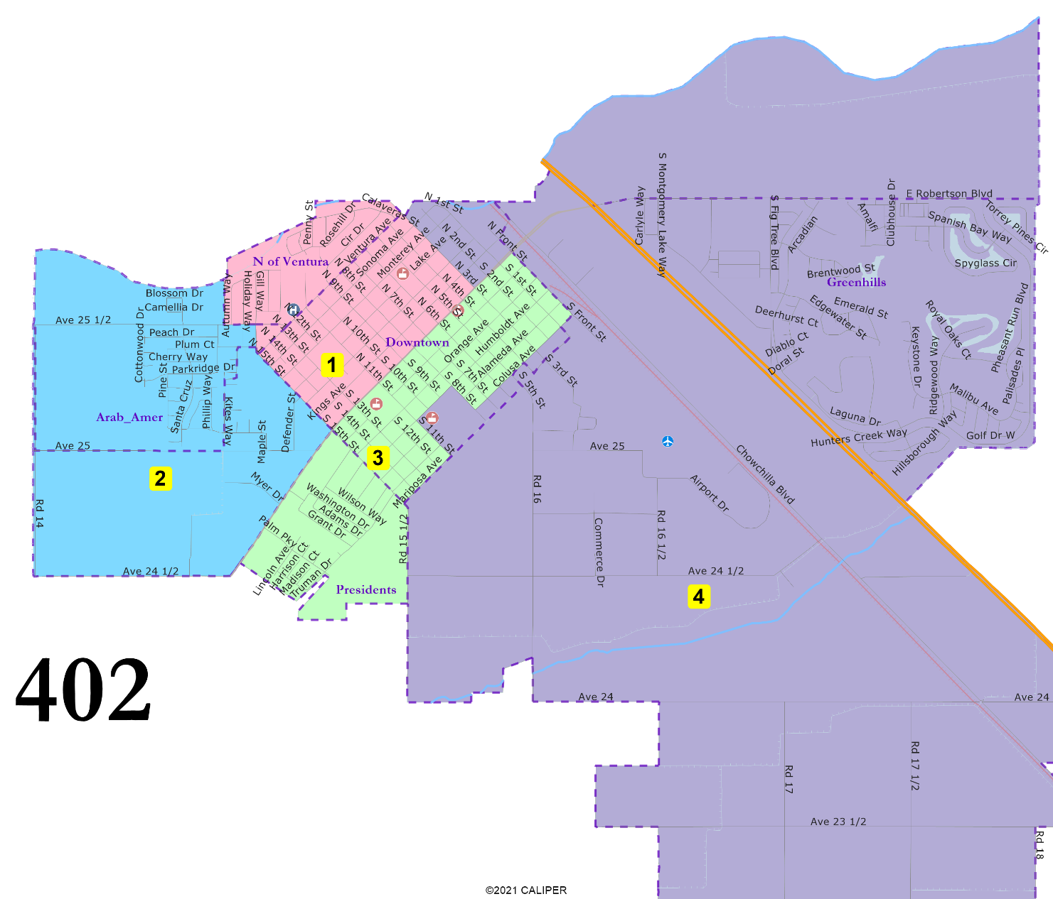
402: 4 districts, elective mayor
“President” Streets united and combined with downtown areas in D3.
North of Ventura united and combined with northern-downtown areas.
Arab-American cultural center area united.
D1 and D3 have large Downtown populations.
Greenhills united.
May 18, 2024

Slide 11
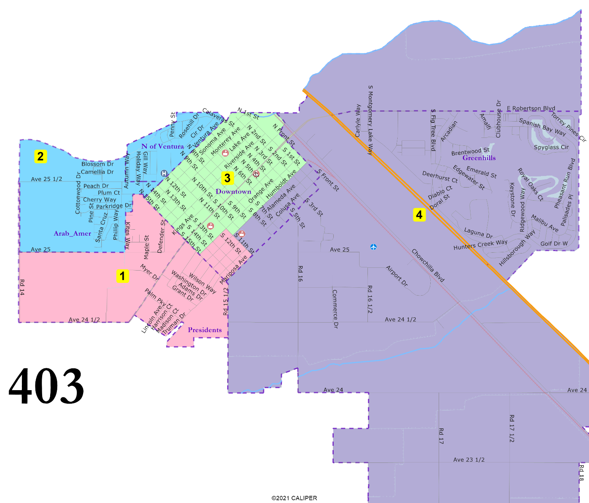
403: 4 districts, elective mayor
“President” Streets united.
North of Ventura united.
Arab-American cultural center area united.
D3 entirely in Downtown.
Greenhills united.
May 18, 2024

Slide 12
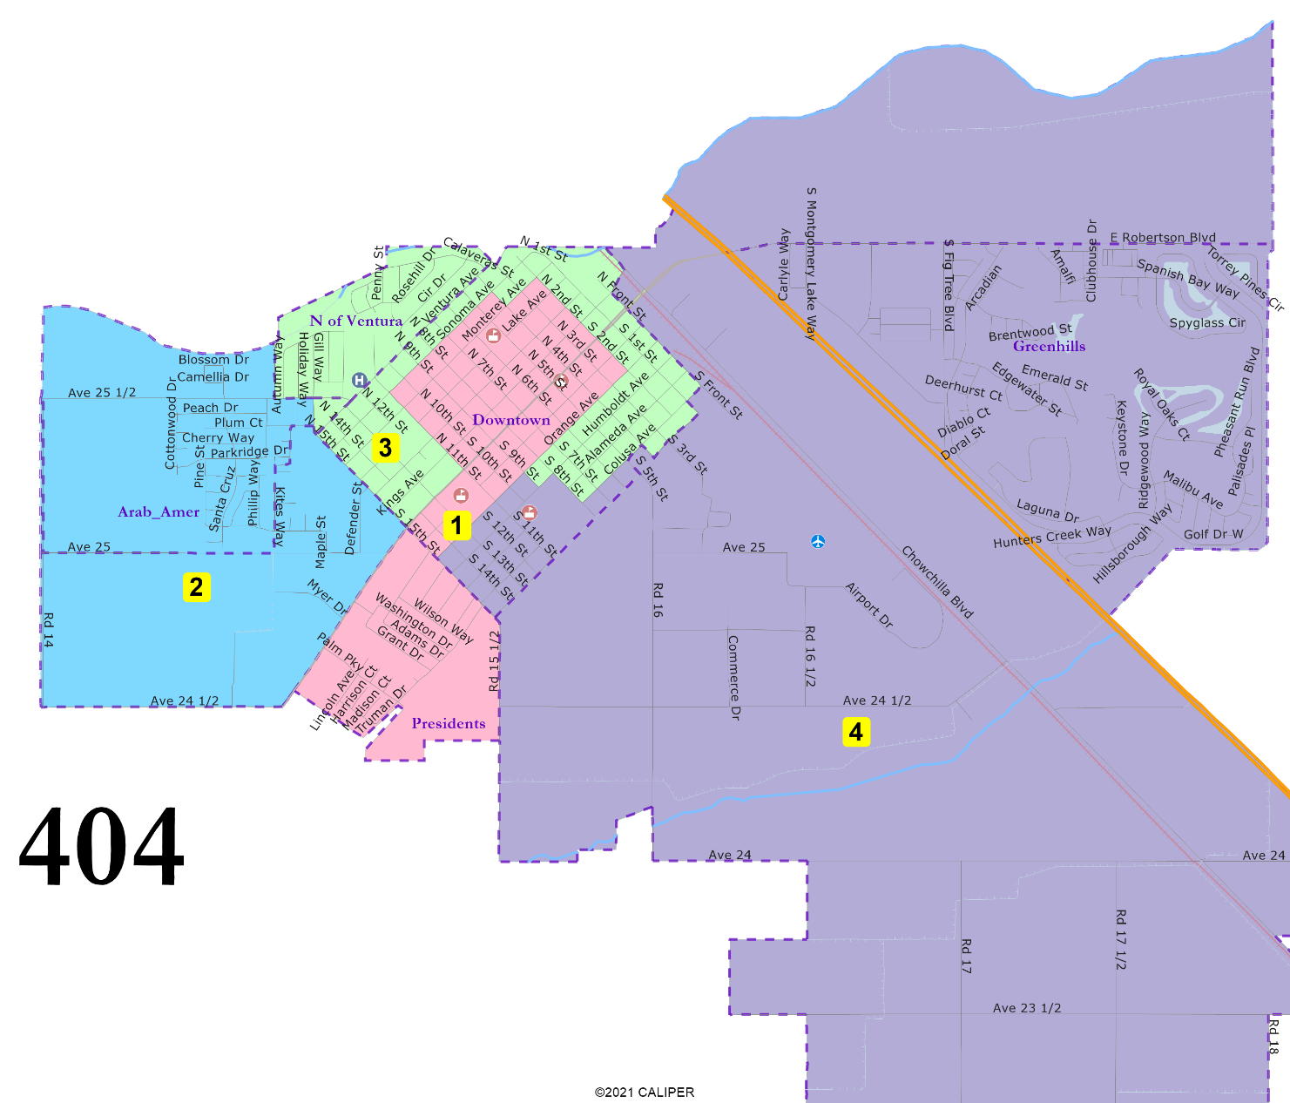
404: 4 districts, elective mayor
“President” Streets united and combined with the heart of Downtown.
D3 is not compact but unites North of Ventura and then follows border of Downtown.
Arab-American cultural center area united.
Greenhills united.
May 18, 2024

Slide 13
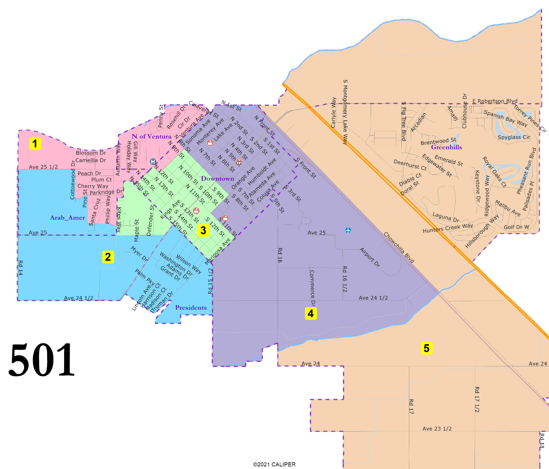
501: 5 districts
“President” Streets united.
D3 is almost entirely Downtown.
D4 is almost entirely Downtown.
Arab-American cultural center area mostly united.
Greenhills united.
May 18, 2024

Slide 14
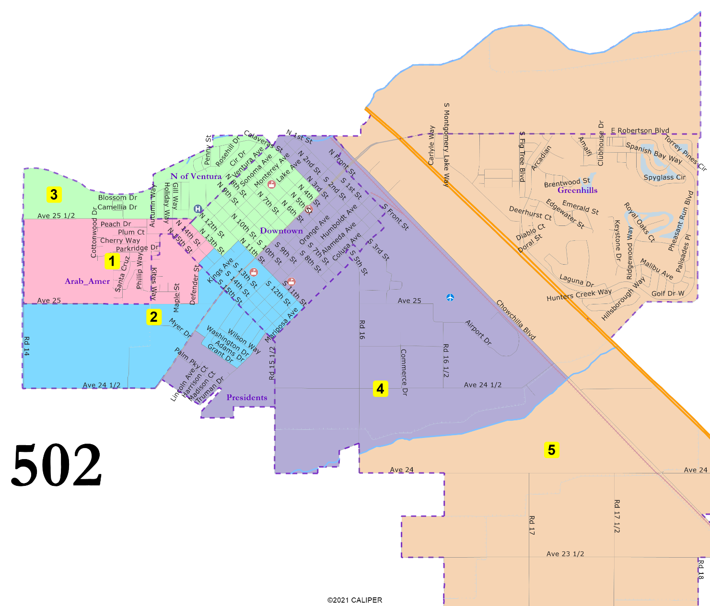
502: 5 districts
“President” Streets in two districts.
Downtown in four districts.
North of Ventura united.
Arab-American cultural center area in two districts.
Greenhills united.
May 18, 2024

Slide 15
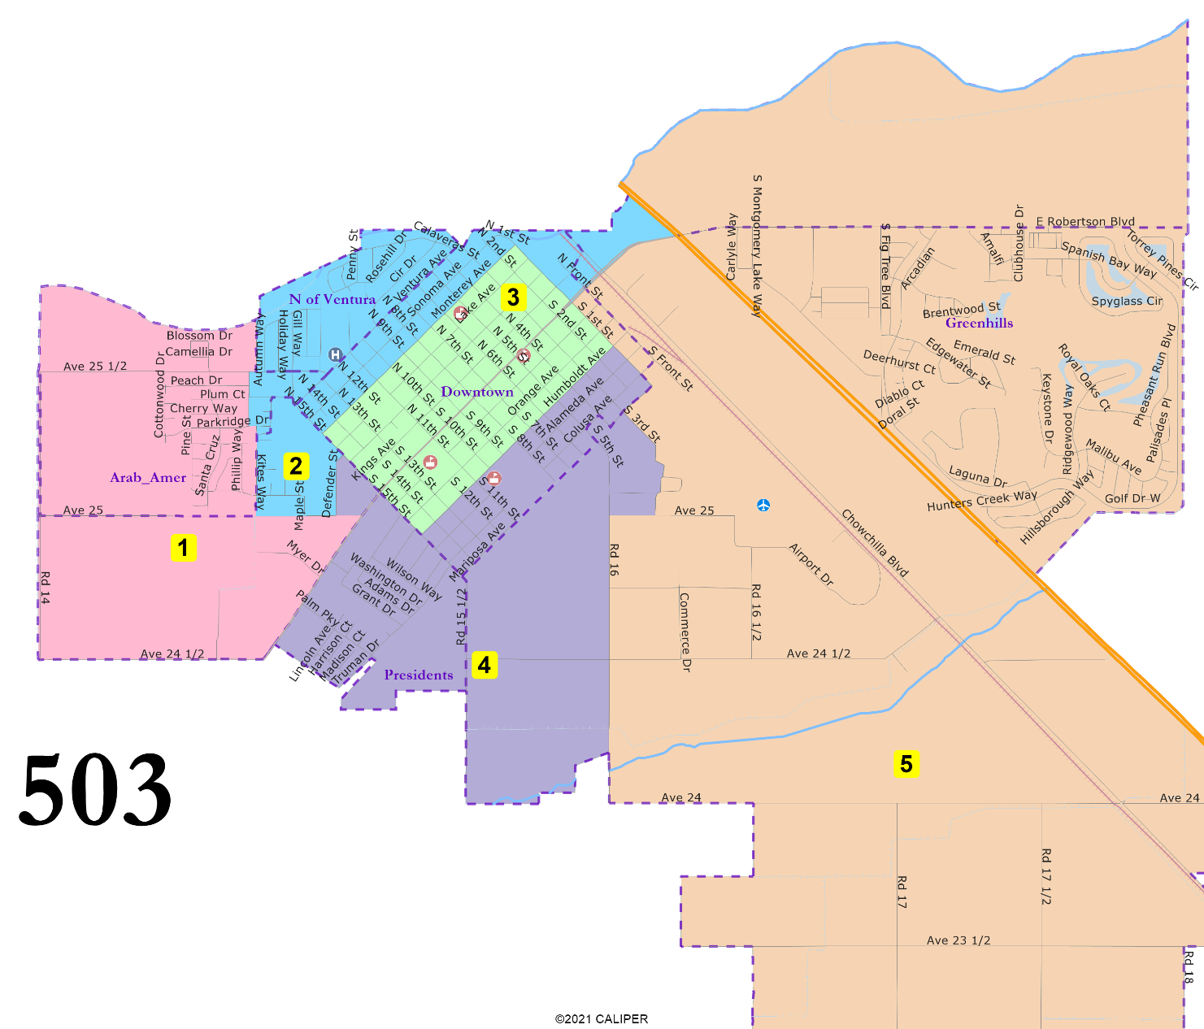
503: 5 districts
“President” Streets united.
D3 entirely in Downtown.
North of Ventura united.
Arab-American cultural center area mostly united in D1.
Greenhills united.
May 18, 2024

Slide 16
Election Year Sequencing
Maps 401, 402, 403:
Proposed:
  2024: Districts 3 & 4
  2026: District 1 & 2
Alternative:
  2024: Districts 1 & 3
  2026: District 2 & 4
Map 404:
2024: Districts 1 & 4
2026: District 1 & 2
(Mayor would also be elected in 2024)
Maps 501 and 502:
Proposed:
  2024: Districts 3, 4 and 5
  2026: District 1 & 2
Alternative:
  2024: Districts 1, 3 & 4
  2026: District 2 & 5
503:
Proposed:
  2024: Districts 1, 3 & 5
  2026: District 2 & 4
Alternative:
  2024: Districts 1, 3 & 4
  2026: District 2 & 5

Slide 17



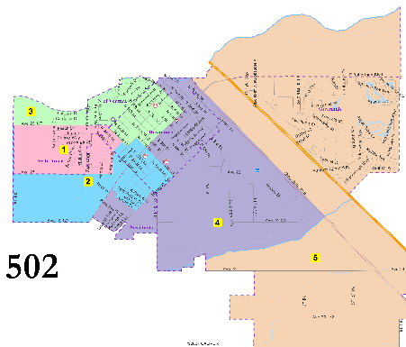

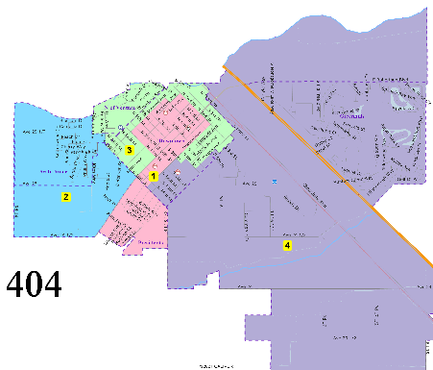

May 18, 2024

