Slide 1
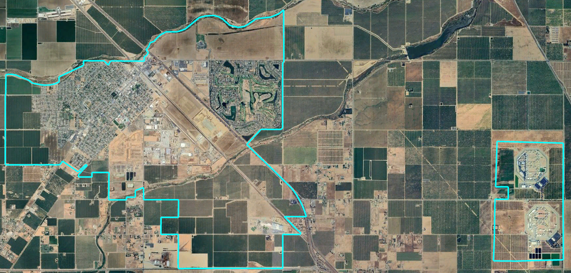
City of Chowchilla
Draft Plans Presentation
Dr. Jeff Tilton, Senior Consultant
National Demographics Corporation

Slide 2
Districting Process
Step | Description
Two Initial Hearings April 9 & April 23 | Held prior to release of draft maps Education and to solicit input on the composition of districts
Release draft maps May 7 | Maps must be posted at least 7 days prior to 3rd hearing
Two hearings on draft maps May 14 & May 28 | Two meetings to discuss and revise the draft maps and to discuss the election sequence
Community Forum May 18 | Learn more about districting in Chowchilla Review draft maps
Map adoption June 11 | Map adopted via Ordinance. Final map must be posted at least 7 days prior to adoption

Slide 3
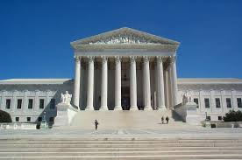
Districting Rules and Goals
1. Federal Laws
2. California Criteria
California Prohibition
Equal Population
Federal Voting Rights Act
No Racial Gerrymandering
In prioritized order:
Geographically contiguous
Undivided neighborhoods and “communities of interest”
(Socio-economic geographic areas that should be kept together)
Easily identifiable boundaries
Compact
(Do not bypass one group of people to get to a more distant group of people)
“Shall not adopt election district boundaries for the purpose of favoring or discriminating against an incumbent, political candidate, or political party.”
Other Traditional
Districting Principles
Future population growth

Slide 4
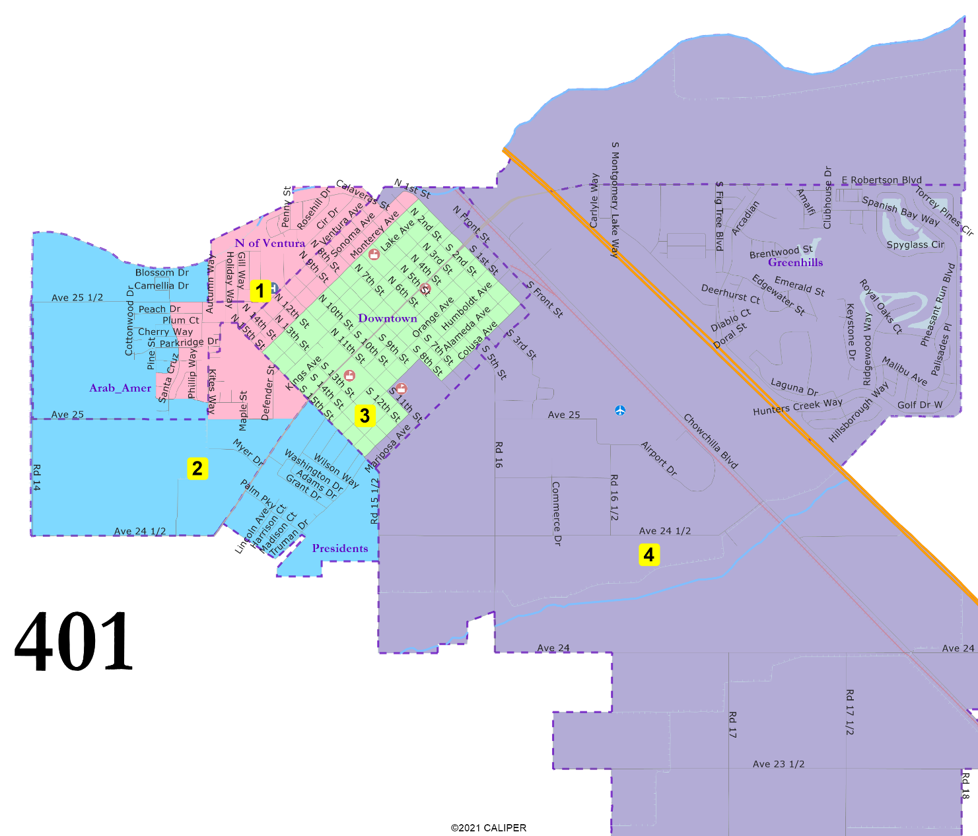
401: 4 districts, elective mayor
“President” Streets united.
North of Ventura united.
D3 entirely in Downtown.
Greenhills united.
May 28, 2024

Slide 5
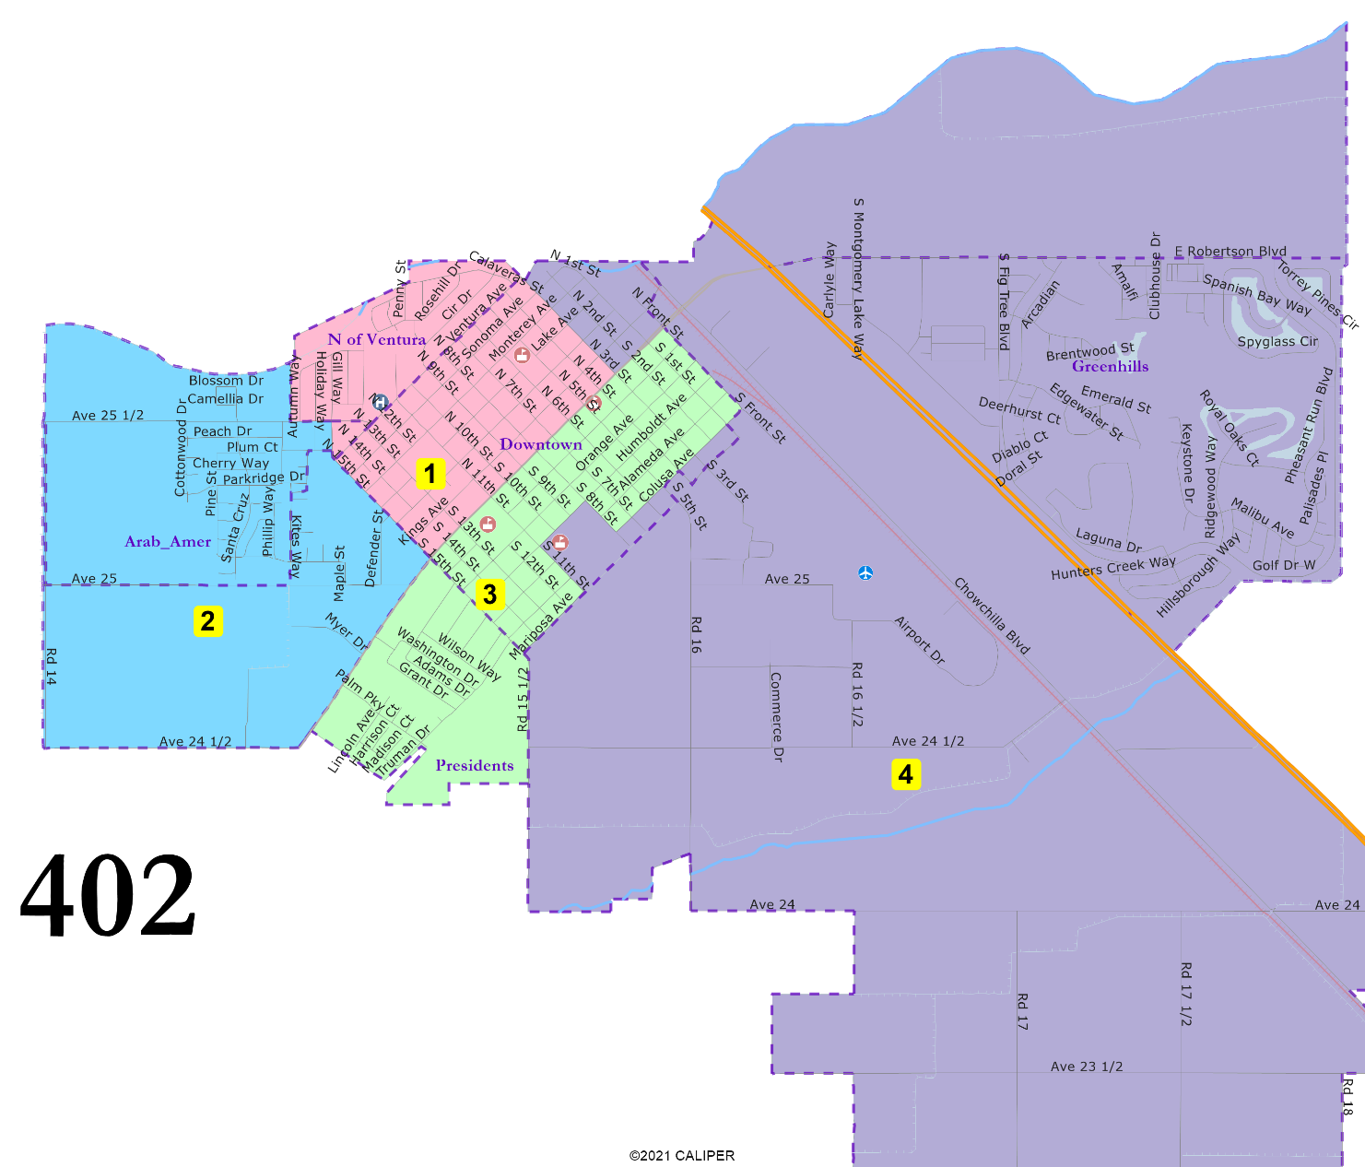
402: 4 districts, elective mayor
“President” Streets united and combined with downtown areas in D3.
North of Ventura united and combined with northern-downtown areas.
Arab-American cultural center area united.
D1 and D3 have large Downtown populations.
Greenhills united.
May 28, 2024

Slide 6
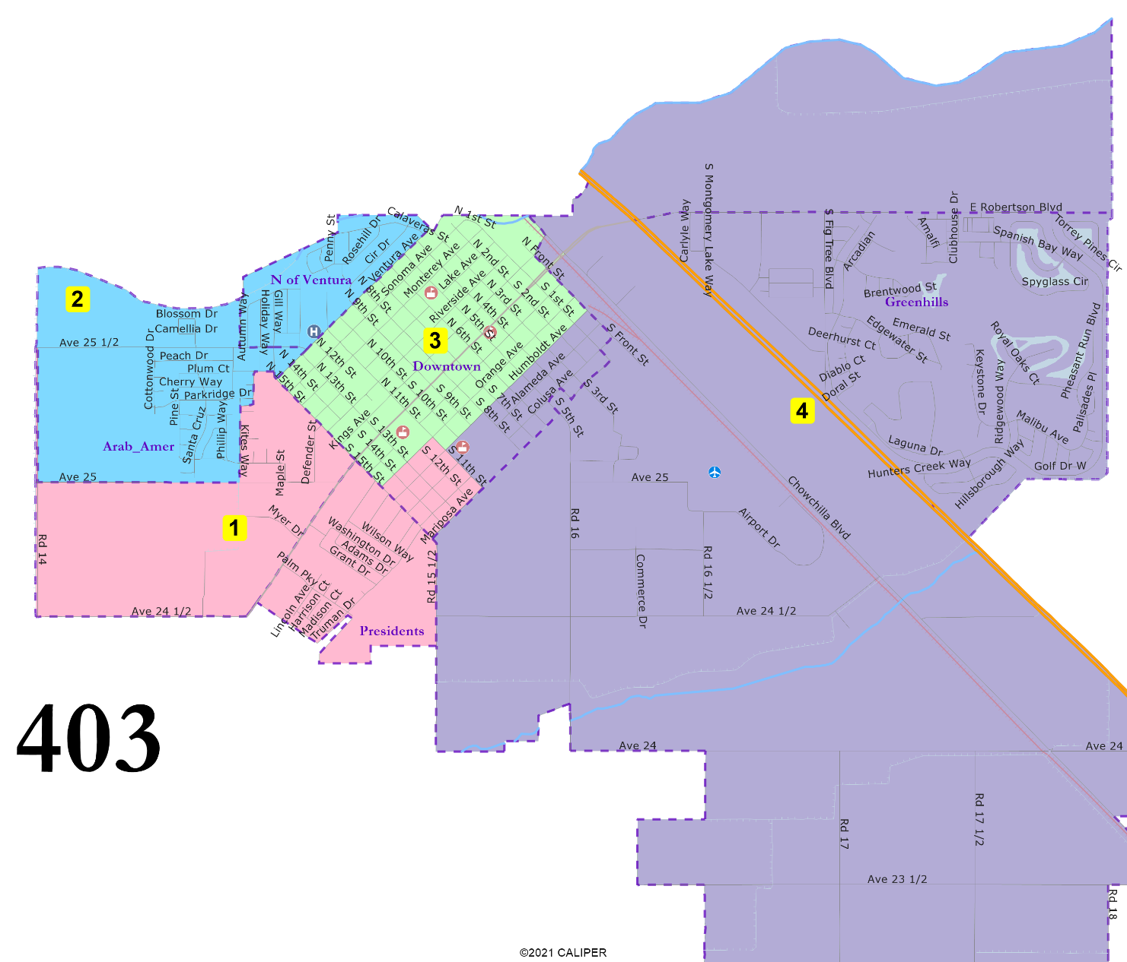
403: 4 districts, elective mayor
“President” Streets united.
North of Ventura united.
Arab-American cultural center area united.
D3 entirely in Downtown.
Greenhills united.
May 28, 2024

Slide 7
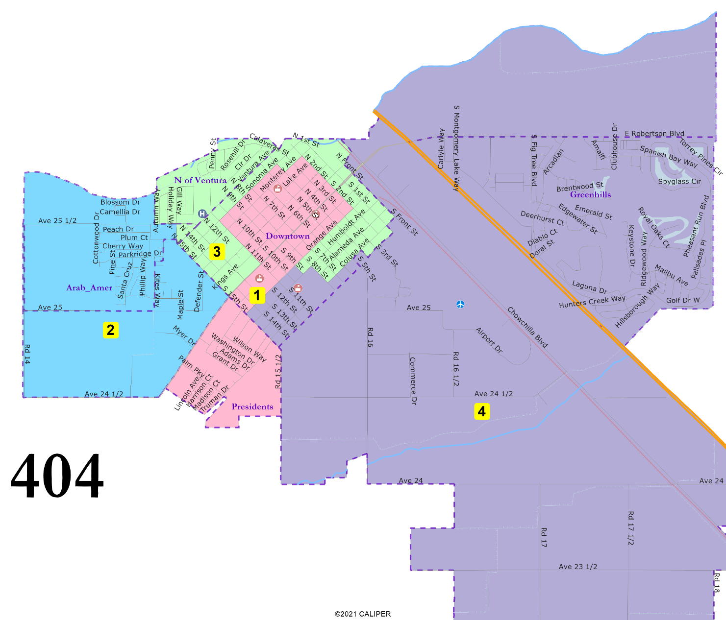
404: 4 districts, elective mayor
“President” Streets united and combined with the heart of Downtown.
D3 is not compact but unites North of Ventura and then follows border of Downtown.
Arab-American cultural center area united.
Greenhills united.
May 28, 2024

Slide 8
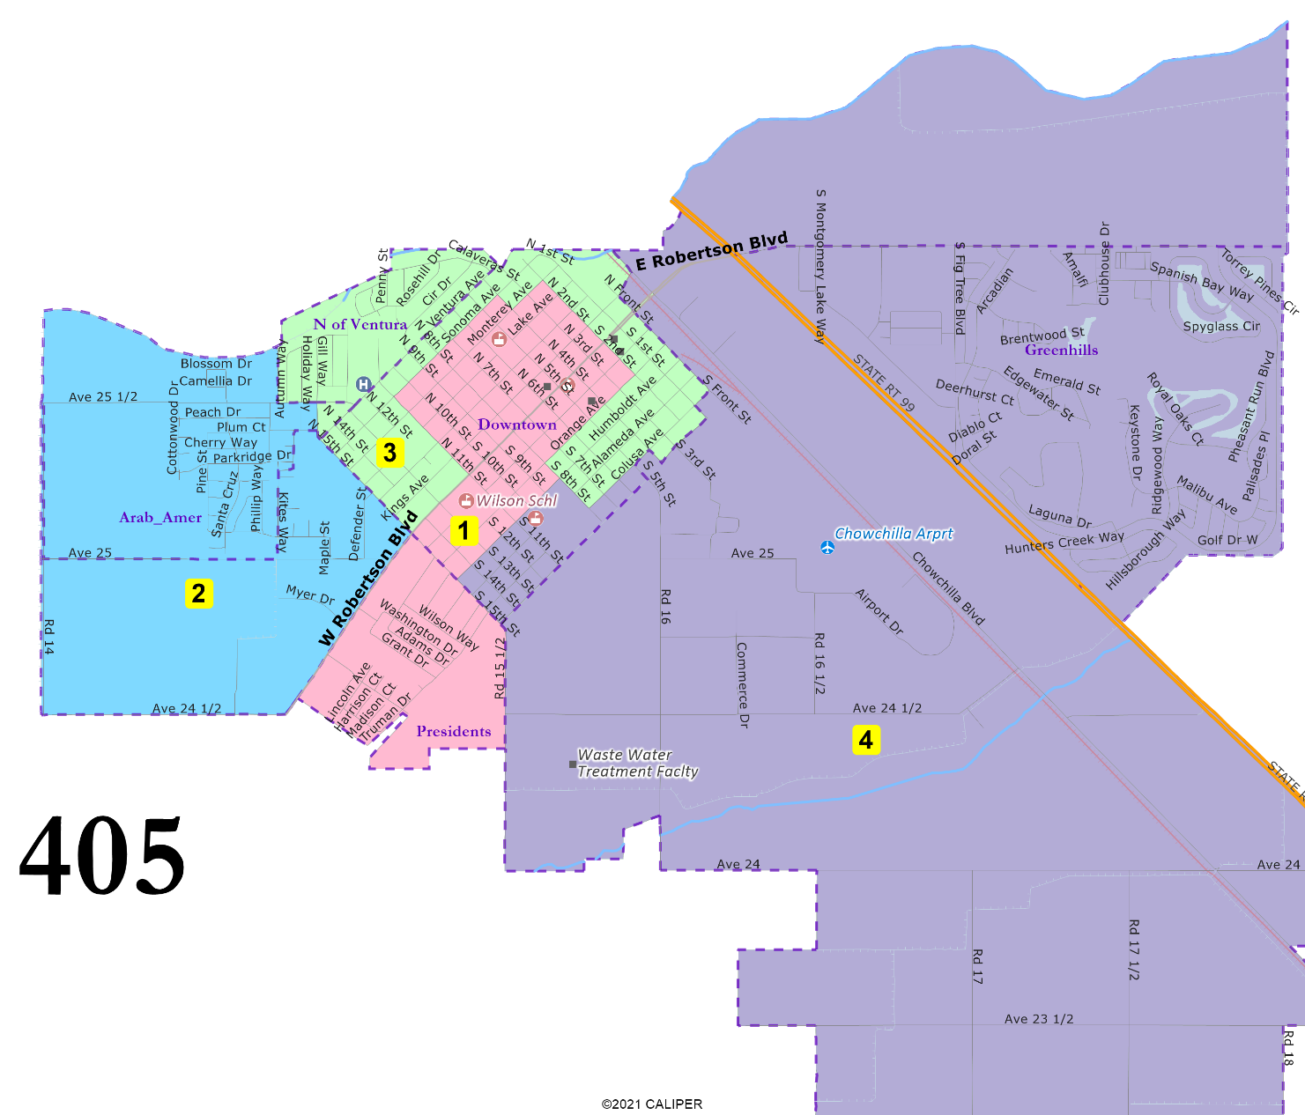
405: 4 districts, elective mayor
Adapted from Map 403
“President” Streets united.
North of Ventura united.
Arab-American cultural center area united.
D3 entirely in Downtown.
Greenhills united.
May 28, 2024

Slide 9
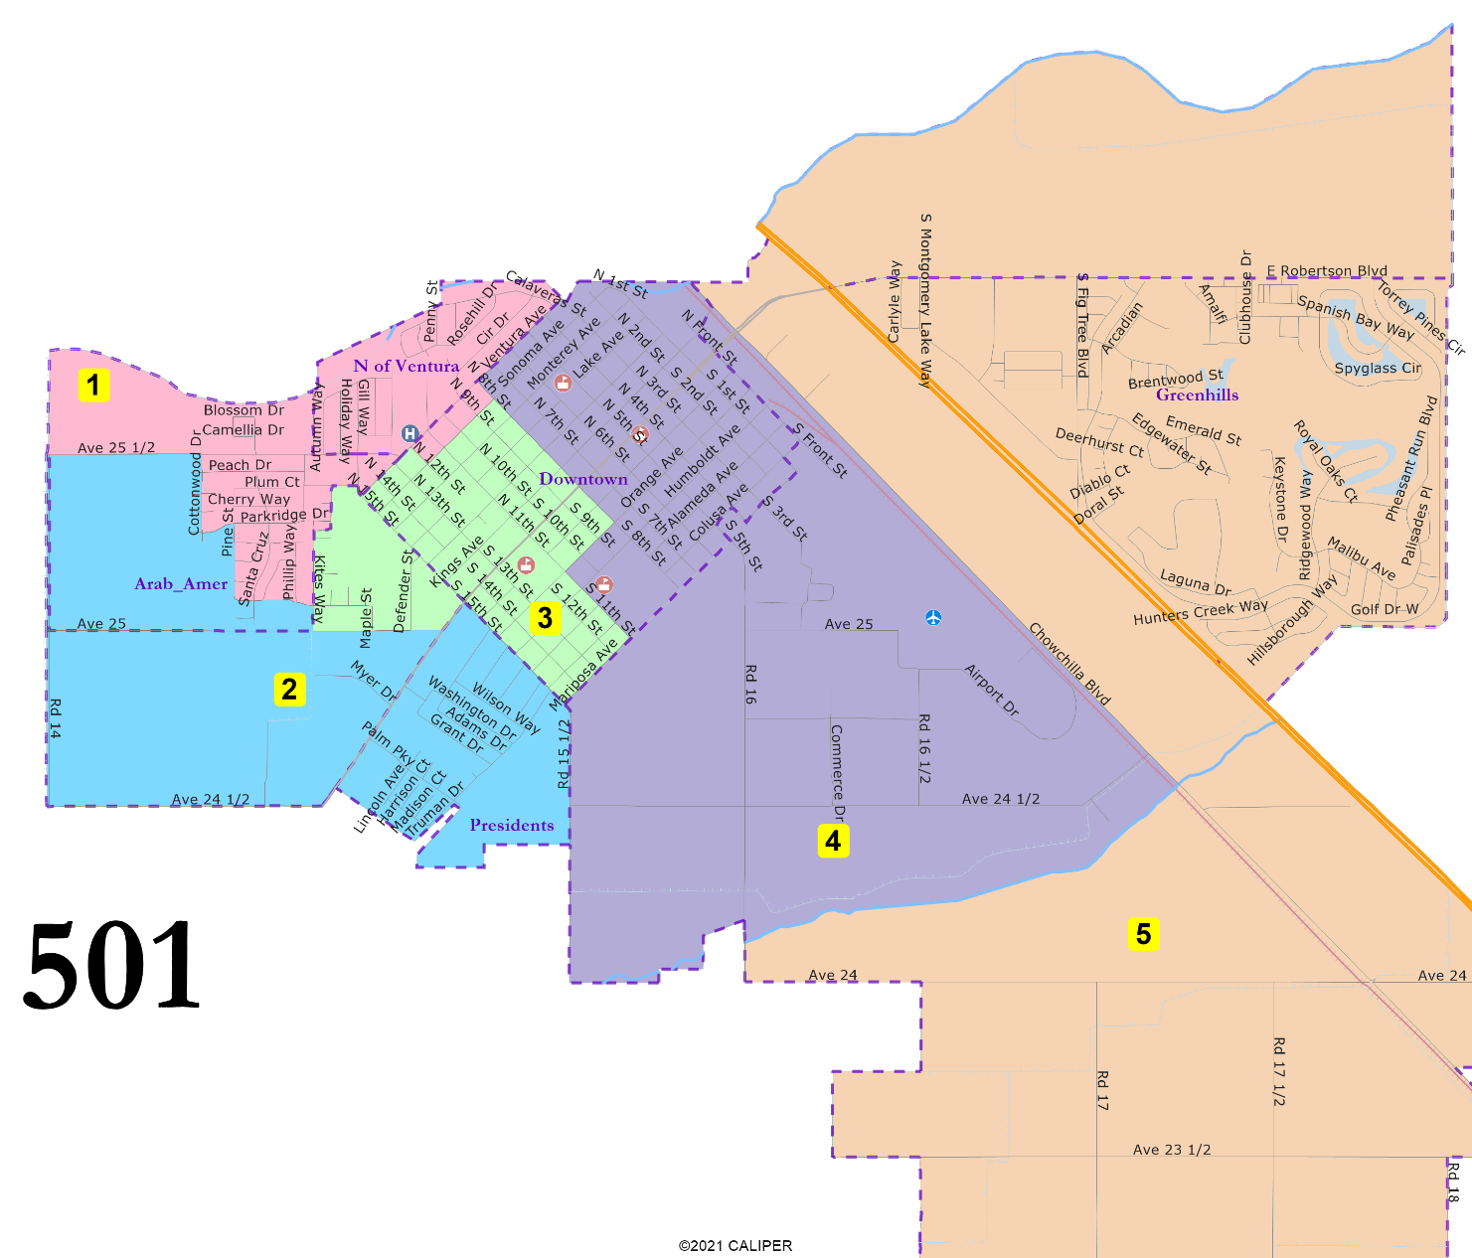
501: 5 districts
“President” Streets united.
D3 is almost entirely Downtown.
D4 is almost entirely Downtown.
Arab-American cultural center area mostly united.
Greenhills united.
May 28, 2024

Slide 10
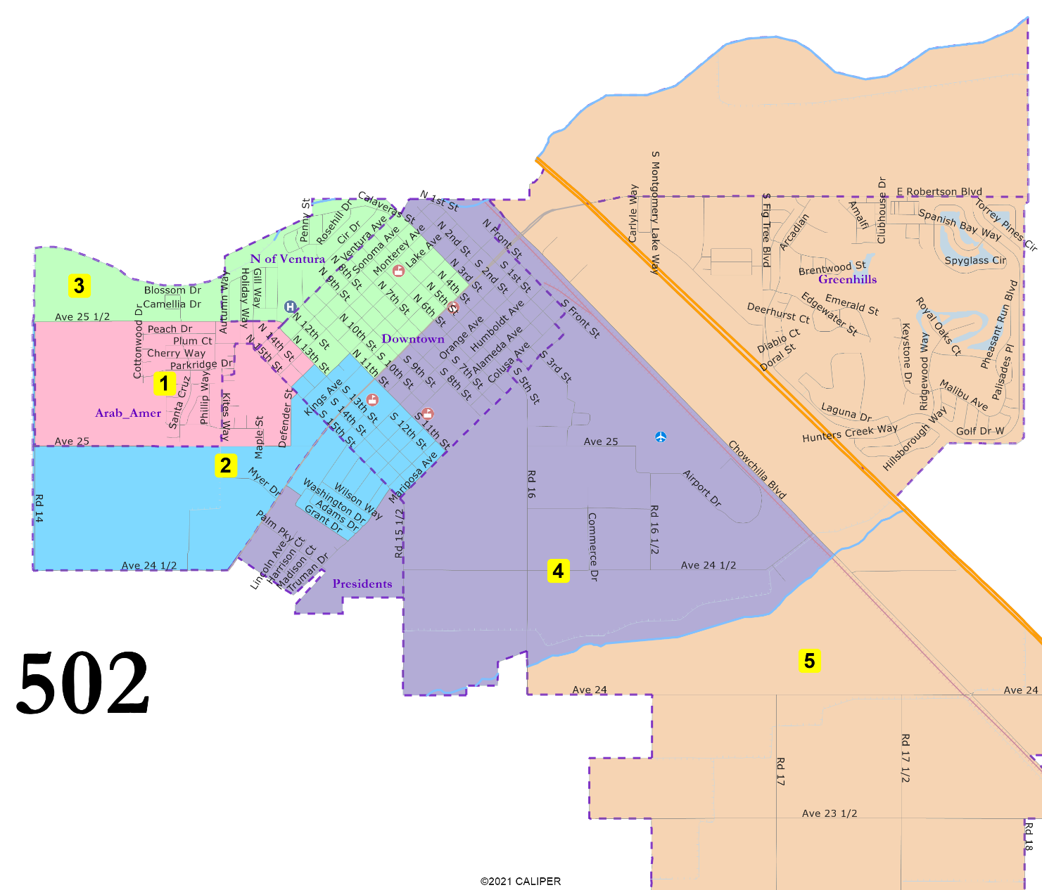
502: 5 districts
“President” Streets in two districts.
Downtown in four districts.
North of Ventura united.
Arab-American cultural center area in two districts.
Greenhills united.
May 28, 2024

Slide 11
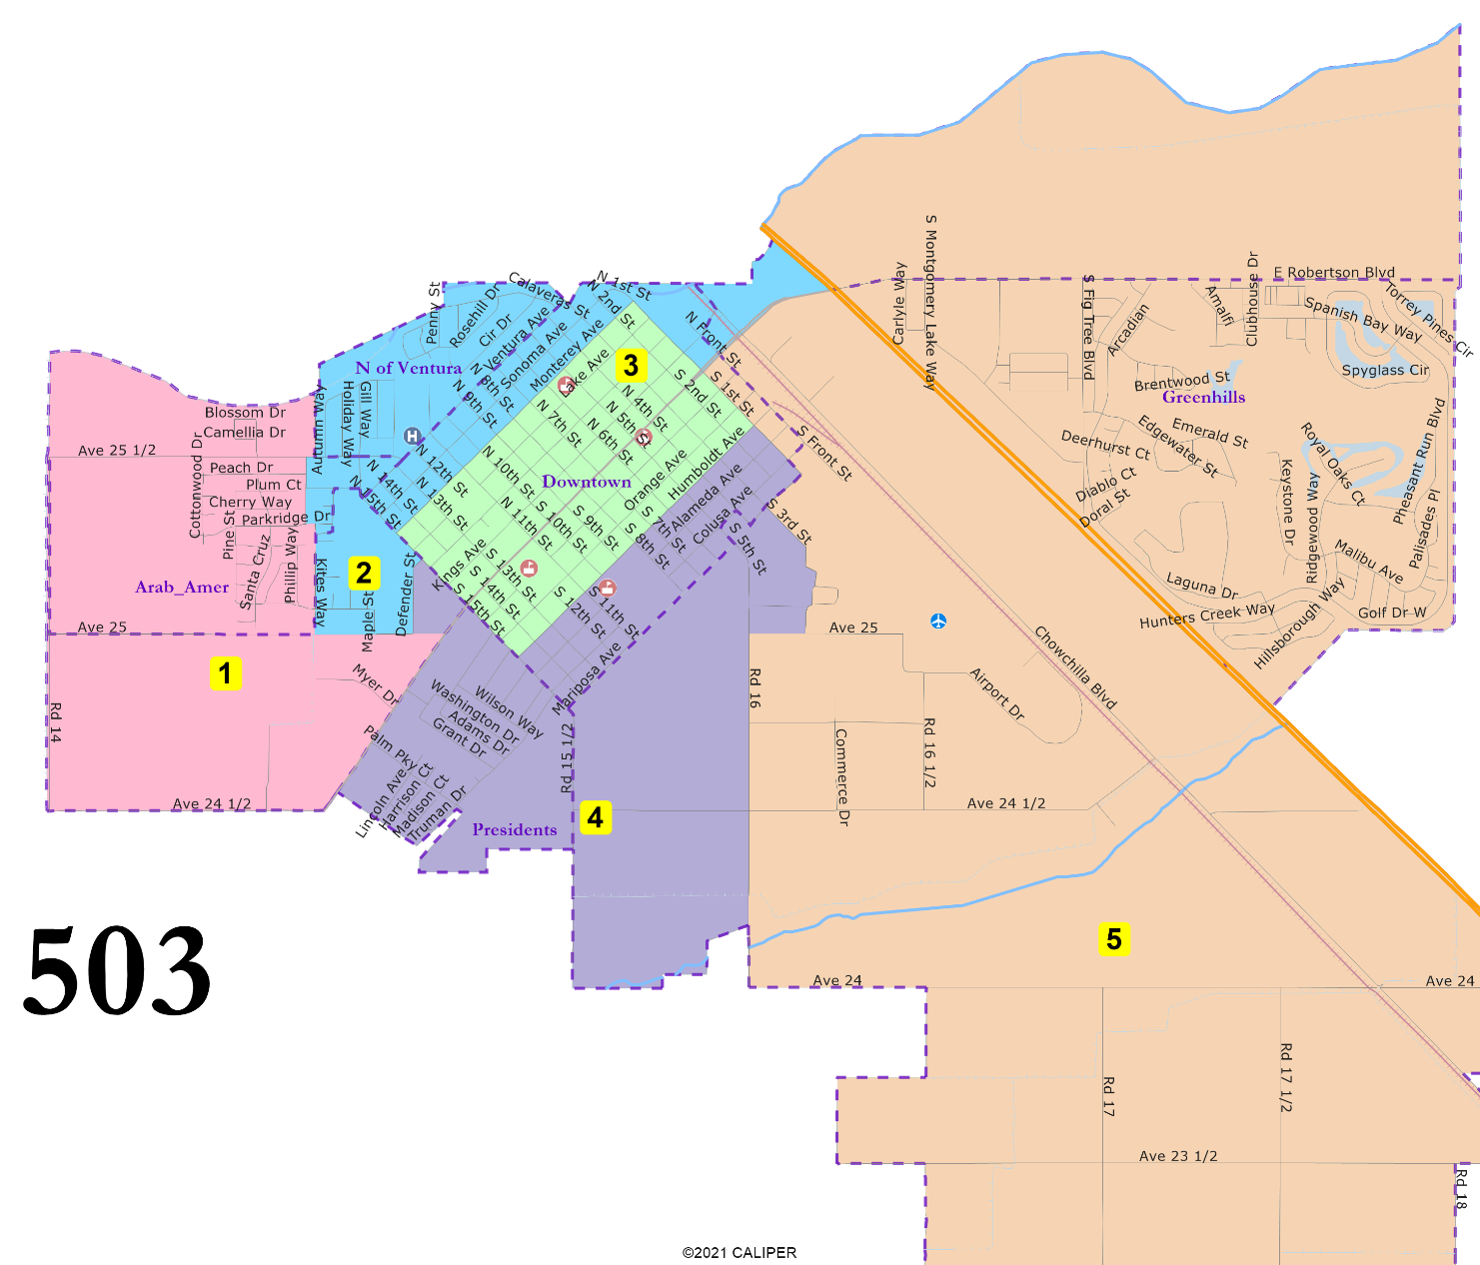
503: 5 districts
“President” Streets united.
D3 entirely in Downtown.
North of Ventura united.
Arab-American cultural center area mostly united in D1.
Greenhills united.
May 28, 2024

Slide 12
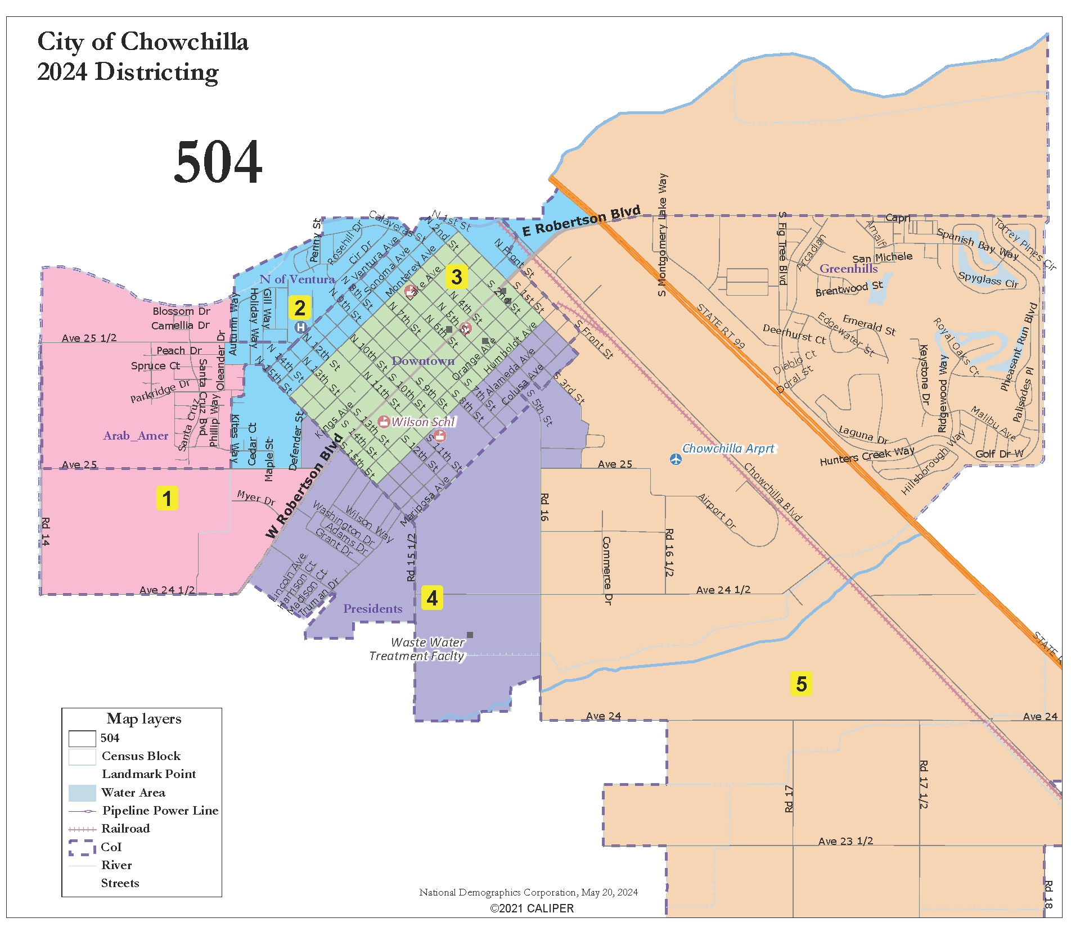
504: 5 districts
Adapted from 503
“President” Streets united.
D3 entirely in Downtown.
North of Ventura united.
Arab-American cultural center area mostly united in D1.
Greenhills united.
May 28, 2024

Slide 13
Election Year Sequencing
Maps 401, 402, 403:
Proposed:
  2024: Districts 3 & 4
  2026: Districts 1 & 2
Alternative:
  2024: Districts 1 & 3
  2026: Districts 2 & 4
Map 404:
2024: Districts 1 & 4
2026: Districts 2 & 3
Map 405:
Proposed:
  2024: Districts 1 & 4
  2026: Districts 2 & 3
Alternative:
  2024: Districts 1 & 3
  2026: Districts 2 & 4
(Mayor would also be elected in 2024)
Maps 501 and 502:
Proposed:
  2024: Districts 3, 4 & 5
  2026: Districts 1 & 2
Alternative:
  2024: Districts 1, 3 & 4
  2026: Districts 2 & 5
Maps 503 and 504:
Proposed:
  2024: Districts 1, 3 & 5
  2026: Districts 2 & 4
Alternative:
  2024: Districts 1, 3 & 4
  2026: Districts 2 & 5

Slide 14



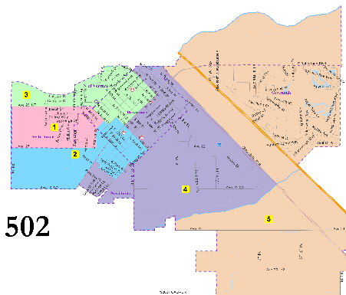



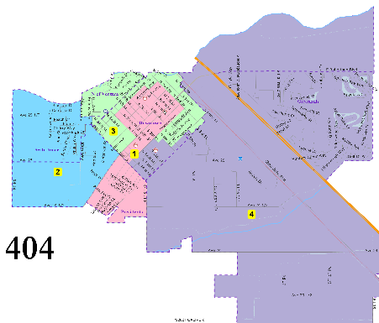
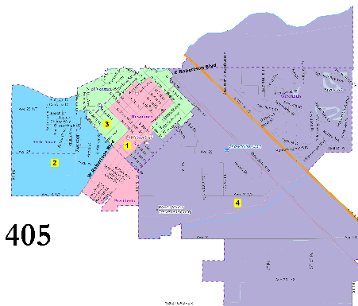
Public Hearing & Discussion
May 28, 2024

