Slide 1
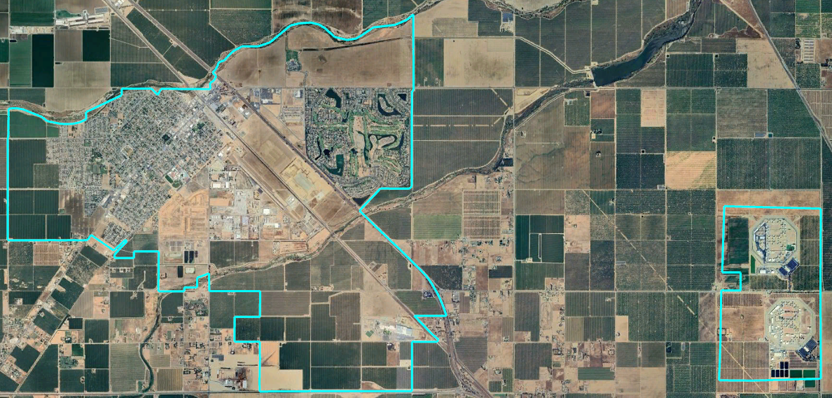
City of Chowchilla
Draft Plans Presentation
Dr. Jeff Tilton, Senior Consultant
National Demographics Corporation

Slide 2
Districting Process
Step | Description
Two Initial Hearings April 9 & April 23 | Held prior to release of draft maps Education and to solicit input on the composition of districts
Release draft maps May 7 | Maps must be posted at least 7 days prior to 3rd hearing
Two hearings on draft maps May 14 & May 28 | Two meetings to discuss and revise the draft maps and to discuss the election sequence
Community Forum May 18 | Learn more about districting in Chowchilla Review draft maps
Special Meeting June 3 | Map selected First reading of Ordinance
Map adoption June 11 | Map adopted via Ordinance. Final map must be posted at least 7 days prior to adoption

Slide 3
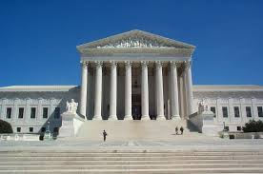
Districting Rules and Goals
1. Federal Laws
2. California Criteria
California Prohibition
Equal Population
Federal Voting Rights Act
No Racial Gerrymandering
In prioritized order:
Geographically contiguous
Undivided neighborhoods and “communities of interest”
(Socio-economic geographic areas that should be kept together)
Easily identifiable boundaries
Compact
(Do not bypass one group of people to get to a more distant group of people)
“Shall not adopt election district boundaries for the purpose of favoring or discriminating against an incumbent, political candidate, or political party.”
Other Traditional
Districting Principles
Future population growth

Slide 4
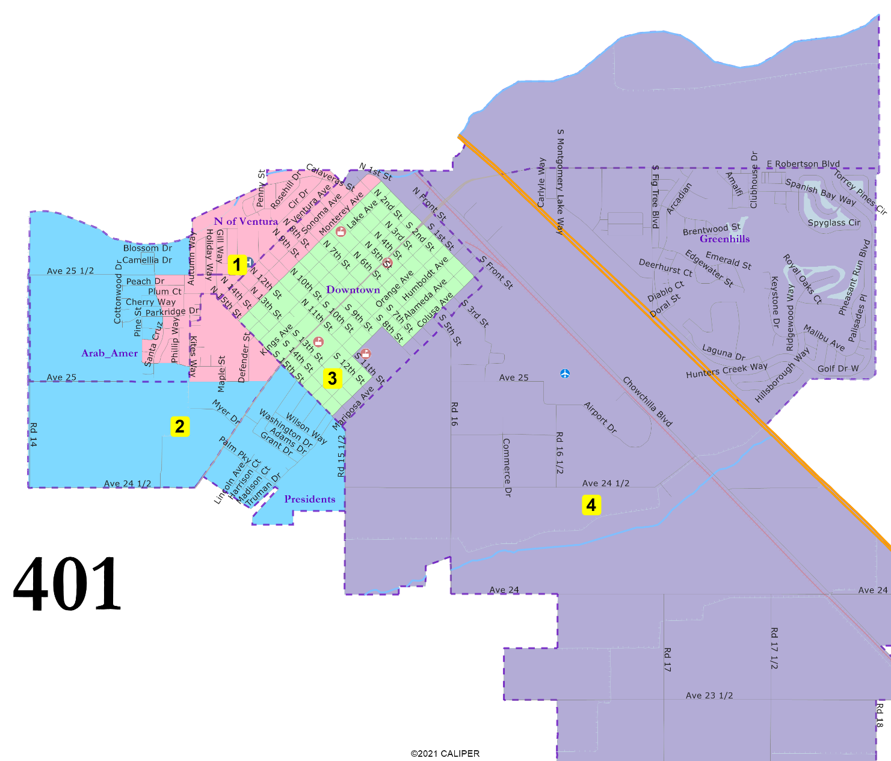
401: 4 districts, elective mayor
“President” Streets united.
North of Ventura united.
D3 entirely in Downtown.
Greenhills united.
June 3, 2024

Slide 5
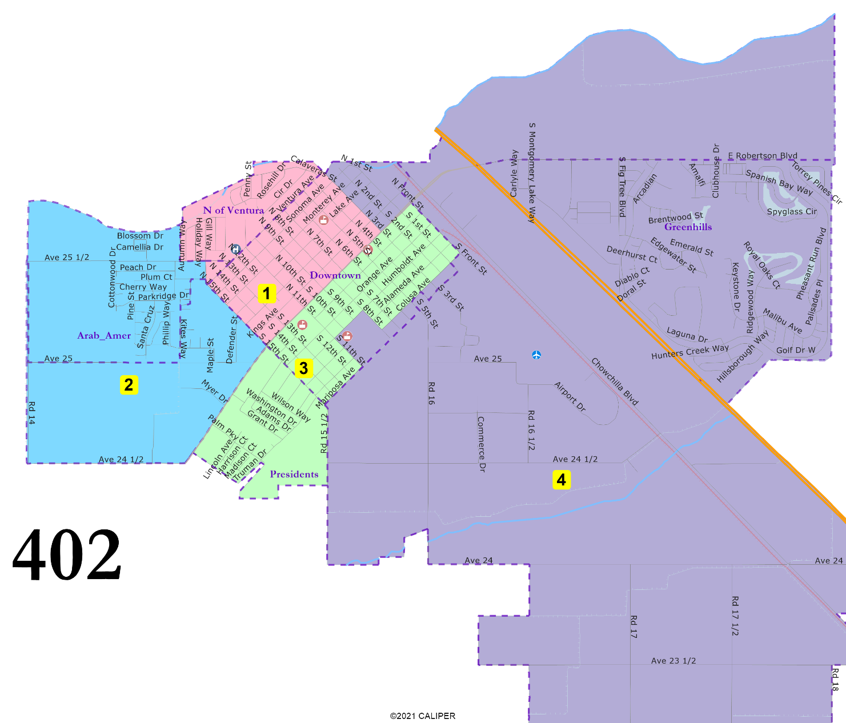
402: 4 districts, elective mayor
“President” Streets united and combined with downtown areas in D3.
North of Ventura united and combined with northern-downtown areas.
Arab-American cultural center area united.
D1 and D3 have large Downtown populations.
Greenhills united.
June 3, 2024

Slide 6
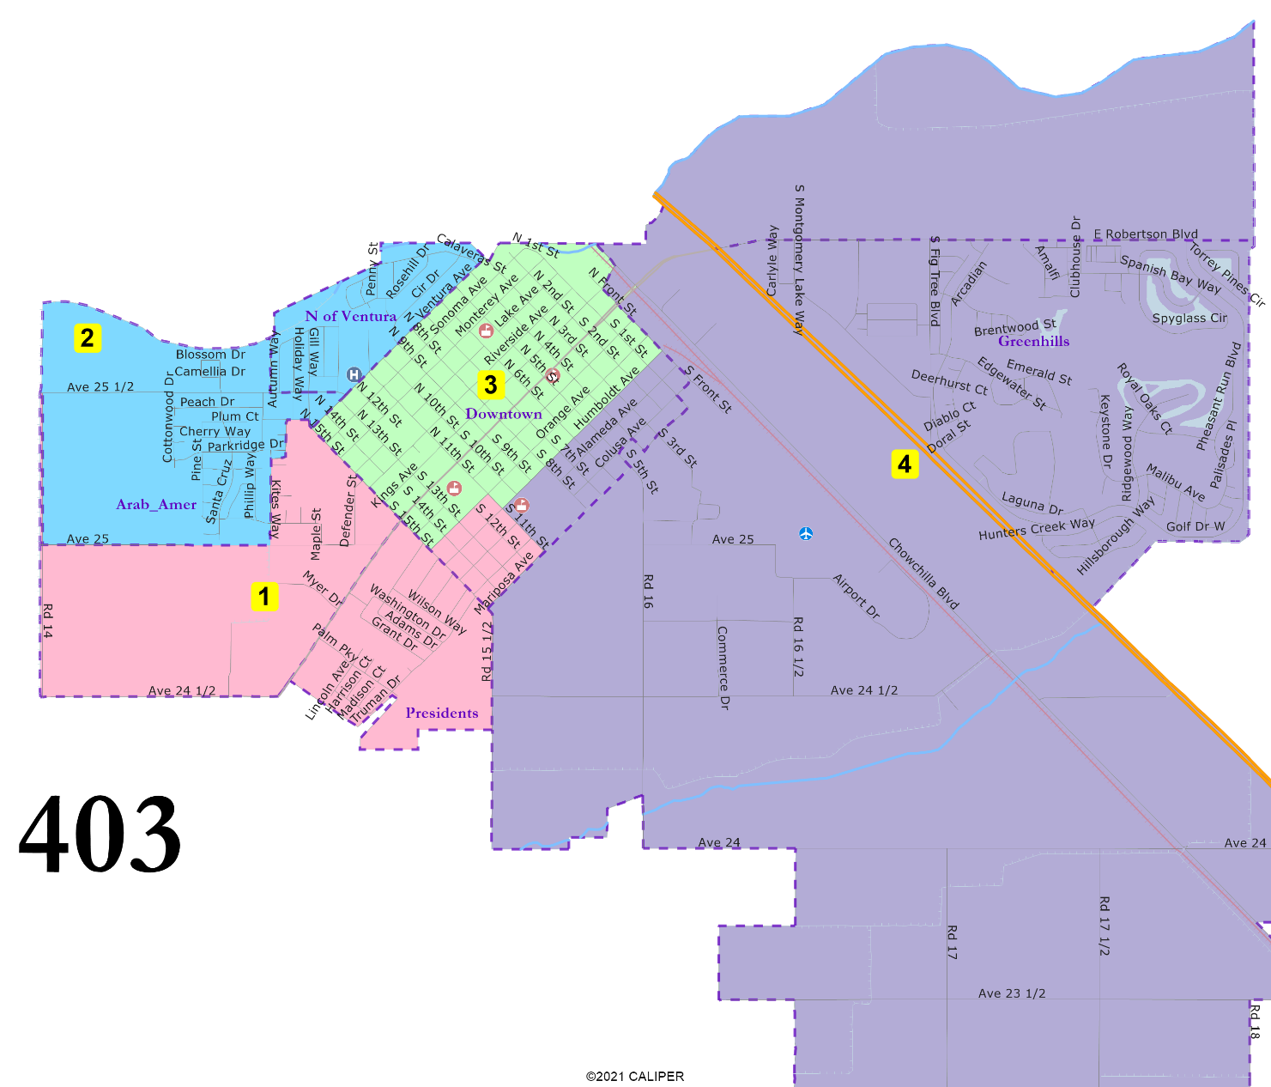
403: 4 districts, elective mayor
“President” Streets united.
North of Ventura united.
Arab-American cultural center area united.
D3 entirely in Downtown.
Greenhills united.
June 3, 2024

Slide 7
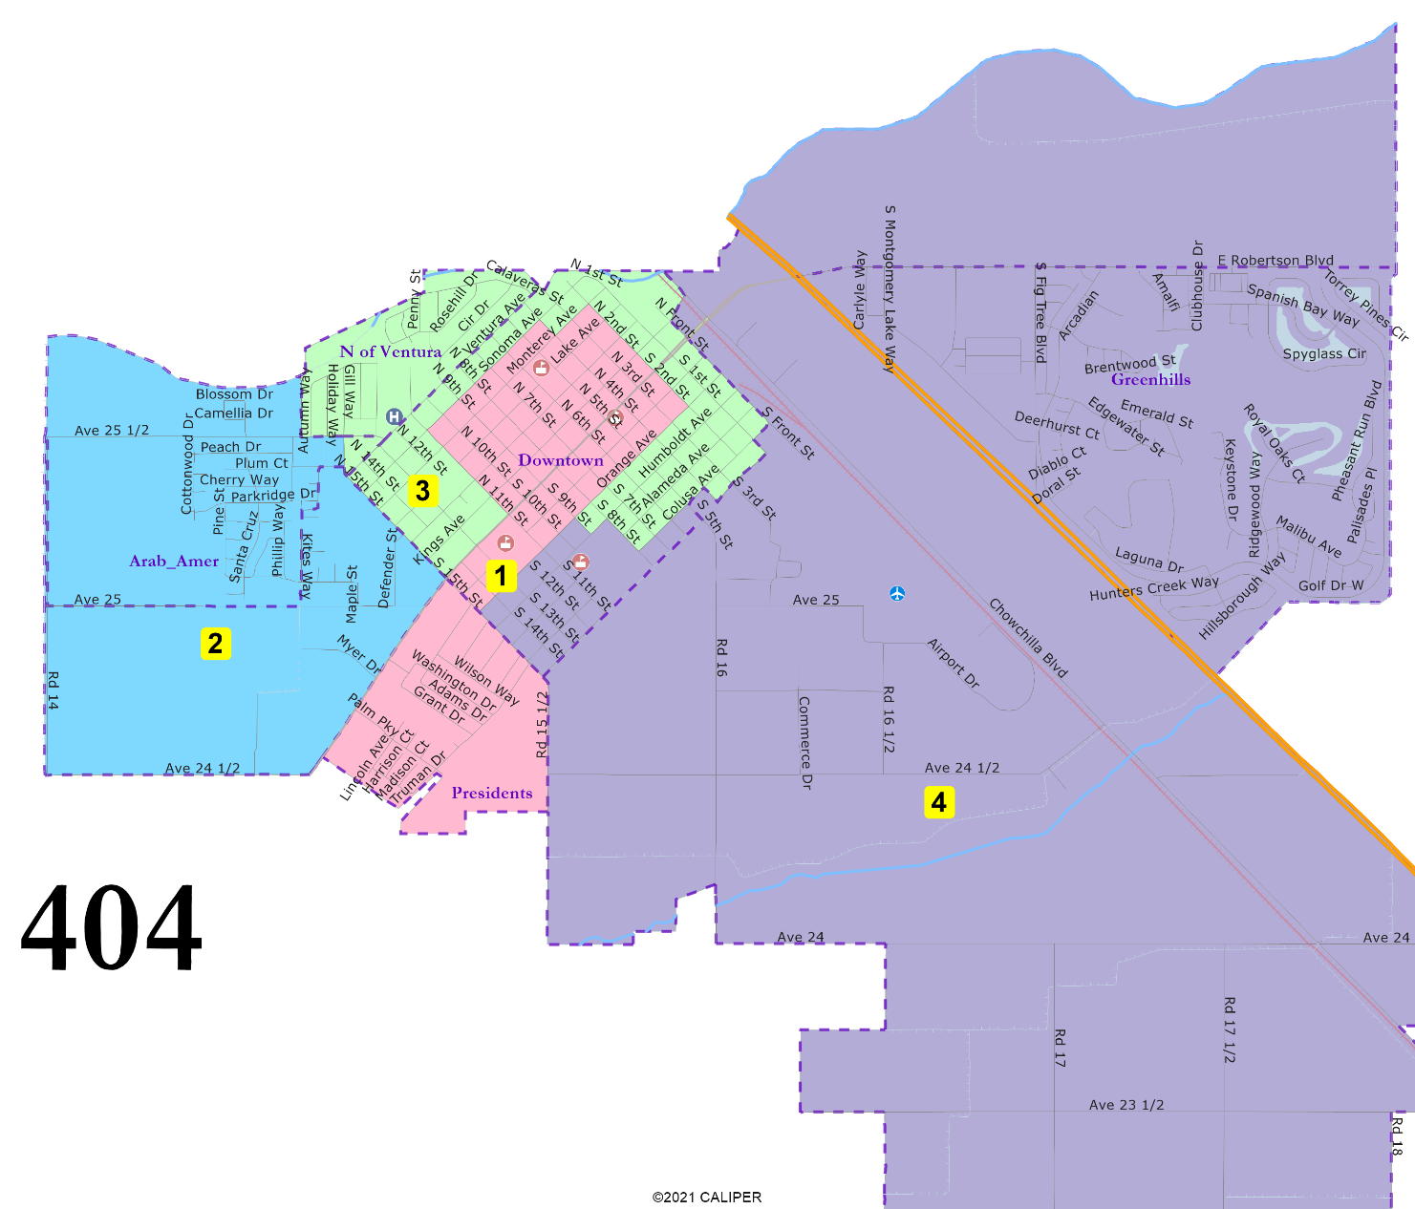
404: 4 districts, elective mayor
“President” Streets united and combined with the heart of Downtown.
D3 is not compact but unites North of Ventura and then follows border of Downtown.
Arab-American cultural center area united.
Greenhills united.
June 3, 2024

Slide 8
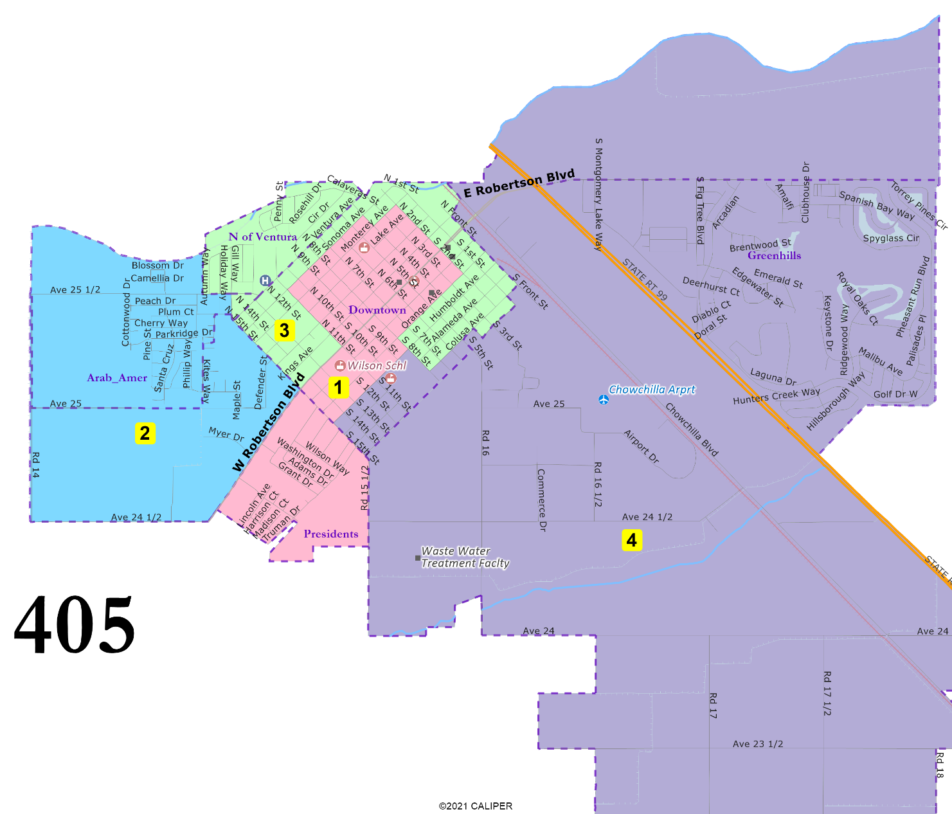
405: 4 districts, elective mayor
Adapted from Map 403
“President” Streets united.
North of Ventura united.
Arab-American cultural center area united.
D3 entirely in Downtown.
Greenhills united.
June 3, 2024

Slide 9
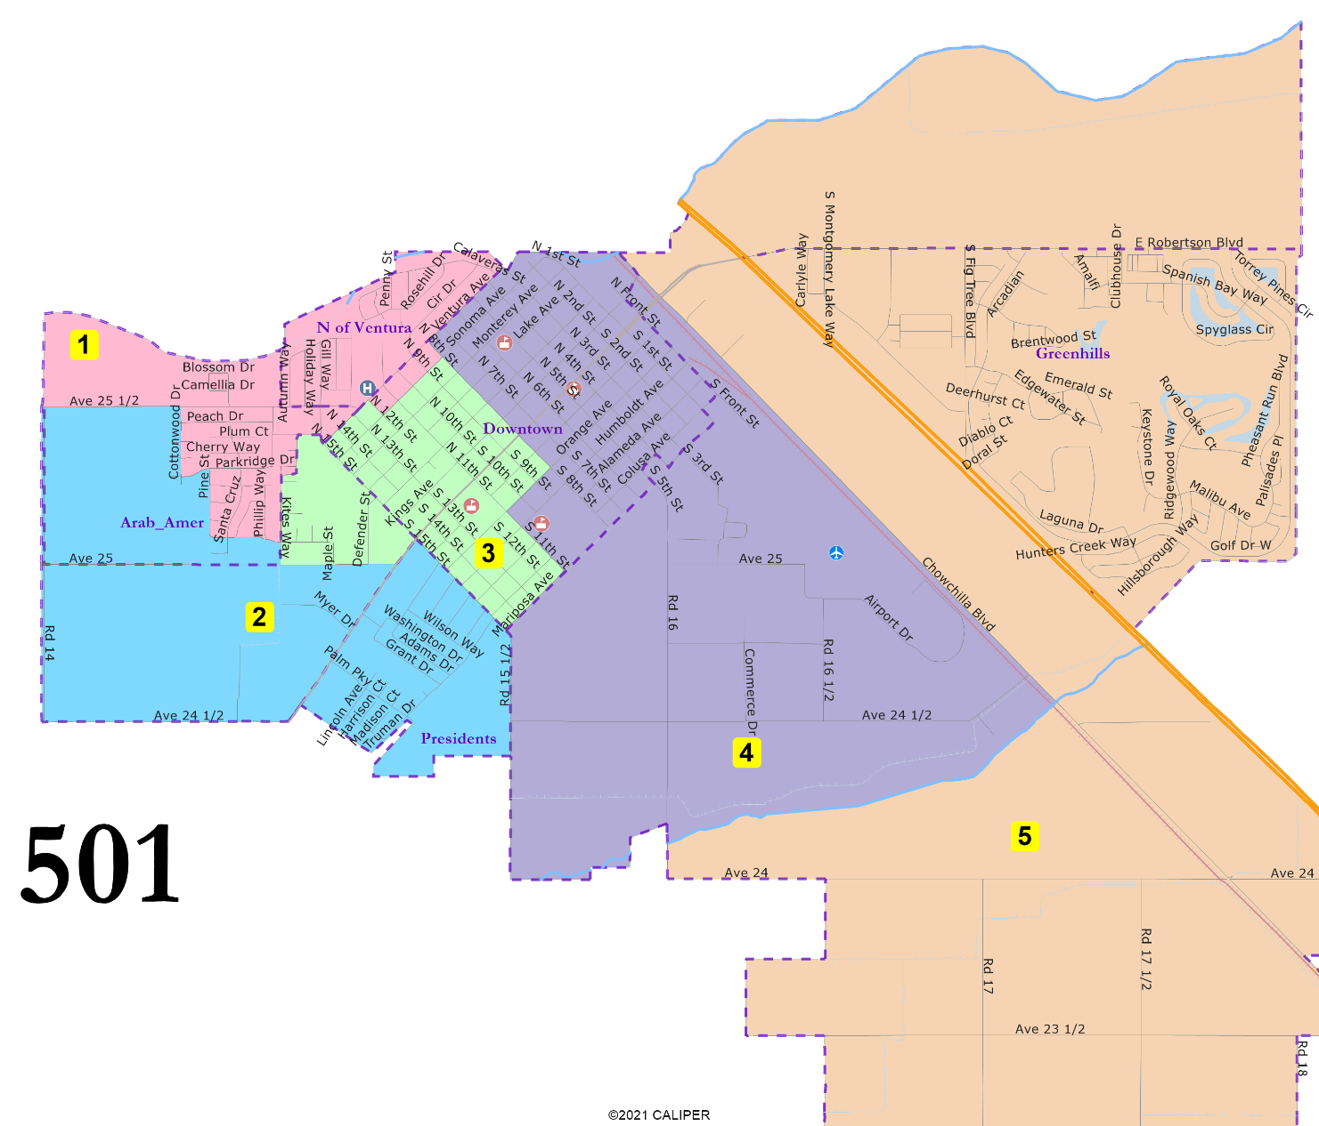
501: 5 districts
“President” Streets united.
D3 is almost entirely Downtown.
D4 is almost entirely Downtown.
Arab-American cultural center area mostly united.
Greenhills united.
June 3, 2024

Slide 10
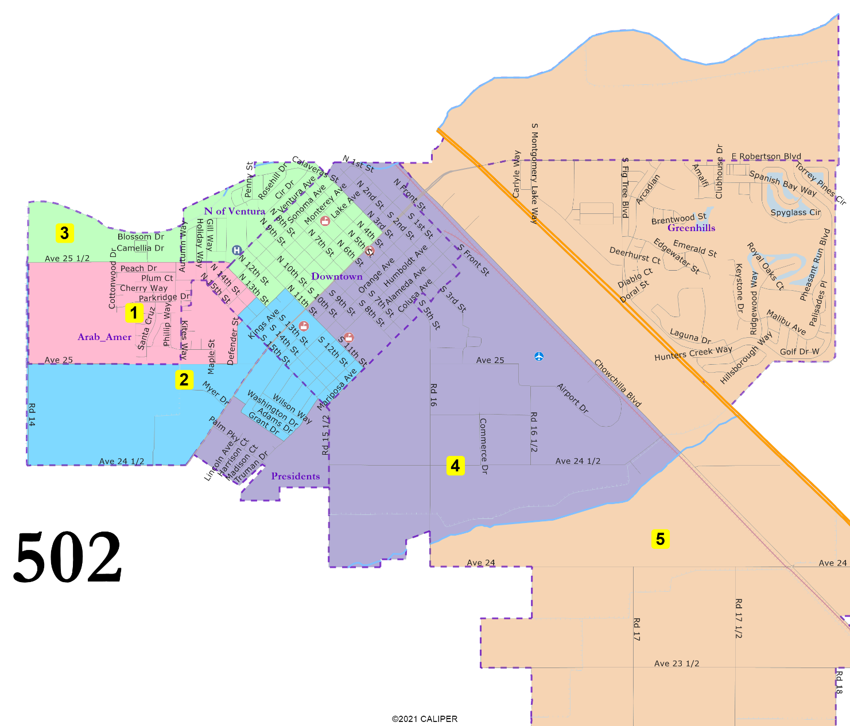
502: 5 districts
“President” Streets in two districts.
Downtown in four districts.
North of Ventura united.
Arab-American cultural center area in two districts.
Greenhills united.
June 3, 2024

Slide 11
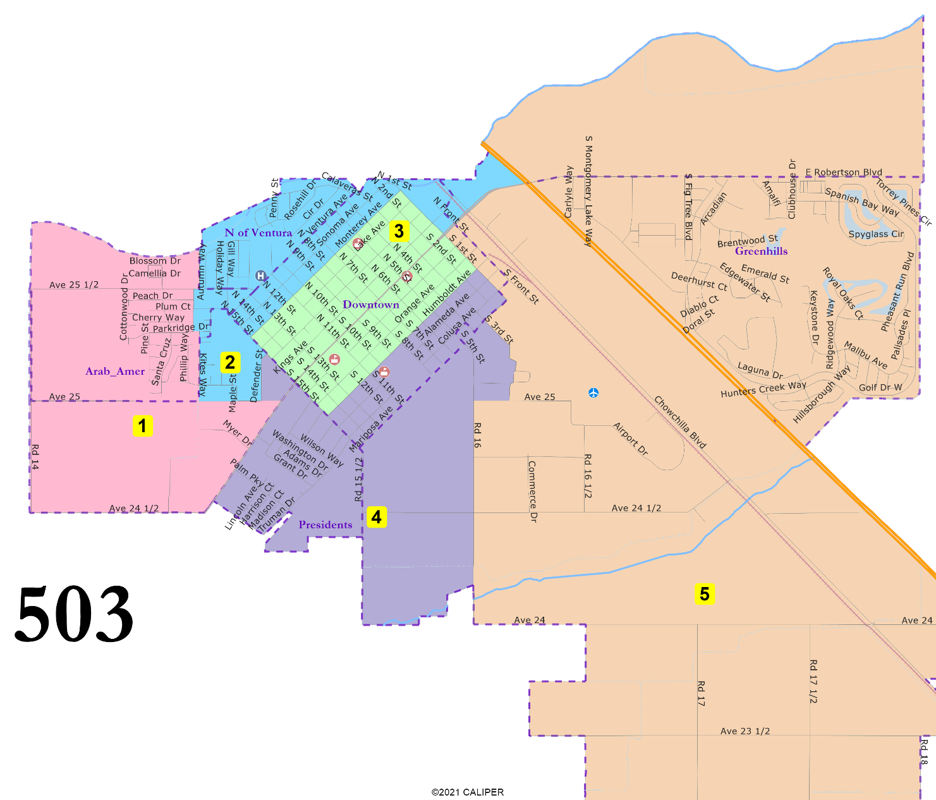
503: 5 districts
“President” Streets united.
D3 entirely in Downtown.
North of Ventura united.
Arab-American cultural center area mostly united in D1.
Greenhills united.
June 3, 2024

Slide 12
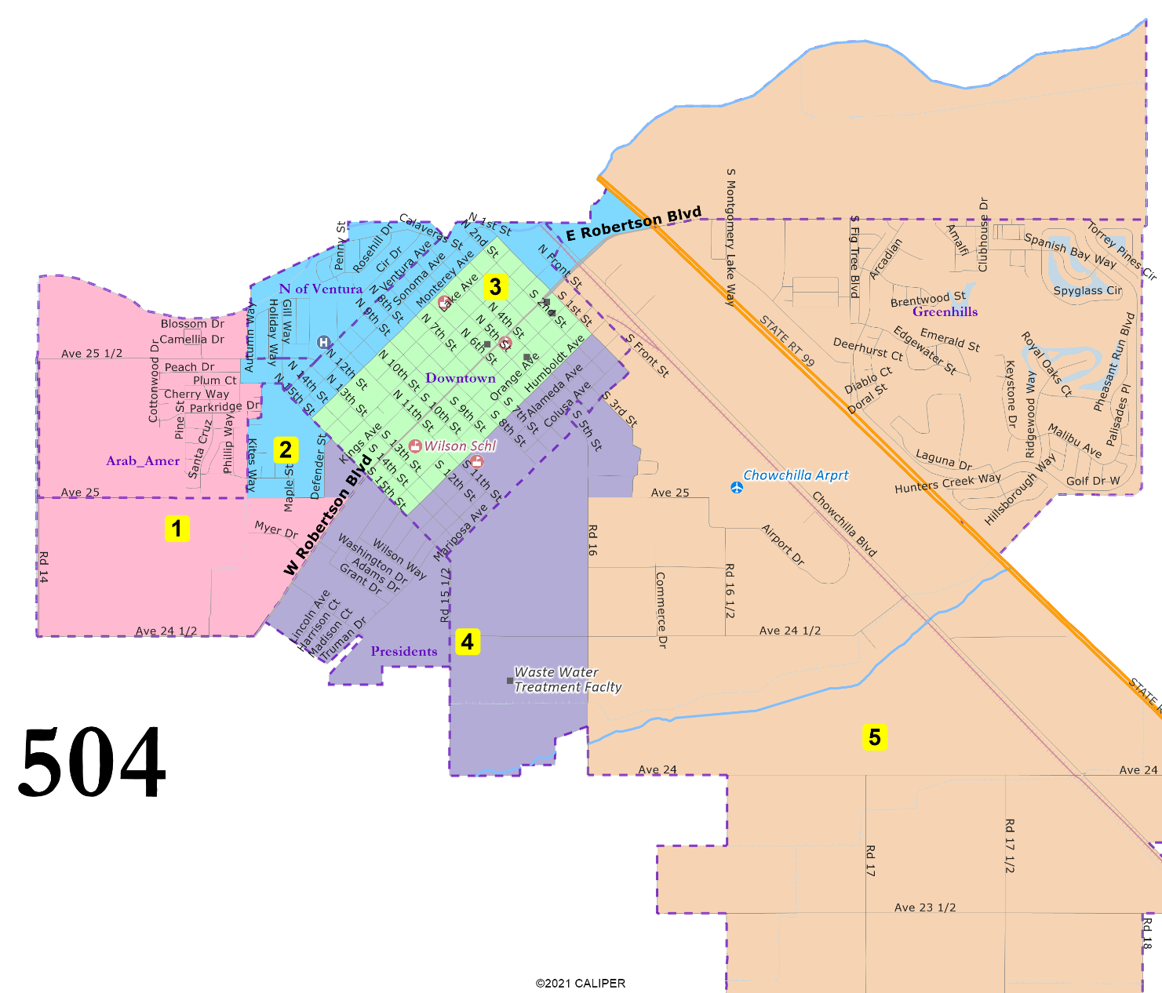
504: 5 districts
Adapted from 503
“President” Streets united.
D3 entirely in Downtown.
North of Ventura united.
Arab-American cultural center area mostly united in D1.
Greenhills united.
June 3, 2024

Slide 13
Election Year Sequencing Rules
Elections Codes Section 10010
  In determining the final sequence of the district elections conducted in a political subdivision in which members of the governing body will be elected at different times to provide for staggered terms of office, the governing body shall give special consideration to the purposes of the California Voting Rights Act of 2001, and it shall take into account the preferences expressed by members of the districts.
Schools Only: Education Code 5021(a)
  If a 2026 and a 2024 trustee are in a seat, some counties say the seat must be up in 2026.

Slide 14
Election Year Sequencing In Practice
Number of seats up in a given election is set and cannot change
Respect the voters: an incumbent alone in a district has the election year assigned to match the incumbent’s term
Vacant seats with traditional low turnout / under-representation:
  If the next election is a (relatively high turnout) Presidential election, assign the seat to the Presidential year
  If the next election is a (relatively low turnout) Gubernatorial election, up to the jurisdiction: elect ASAP but in a low turnout year forever, or wait two years to be in a high turnout year forever.

Slide 15
Election Year Sequencing Scenarios
 | Resides in District electing in 2024 | Resides in District electing in 2026
Term ends in 2024 | Runs for election in district at end of current term | Leaves office at end of current term in 2024. Can run (but not as incumbent) when district is up for election in 2026.
Term ends in 2026 | Option 1: Leaves office at end of current term in 2026. Can run (but not as incumbent) when district is up for election again in 2028. Option 2: In 2024, runs for by-district seat. If elected, is sworn into by-district 4-year term, creating a vacancy for remaining two years of at-large term, which is filled by appointment or special election. | Runs for election in district at end of current term

Slide 16
Election Year Sequencing
Maps 401, 402, 403:
Proposed:
  2024: Districts 3 & 4
  2026: Districts 1 & 2
Alternative:
  2024: Districts 1 & 3
  2026: Districts 2 & 4
Map 404:
2024: Districts 1 & 4
2026: Districts 2 & 3
Map 405:
Proposed:
  2024: Districts 1 & 4
  2026: Districts 2 & 3
Alternative:
  2024: Districts 1 & 3
  2026: Districts 2 & 4
(Mayor would also be elected in 2024)
Maps 501 and 502:
Proposed:
  2024: Districts 3, 4 & 5
  2026: Districts 1 & 2
Alternative:
  2024: Districts 1, 3 & 4
  2026: Districts 2 & 5
Maps 503 and 504:
Proposed:
  2024: Districts 1, 3 & 5
  2026: Districts 2 & 4
Alternative:
  2024: Districts 1, 3 & 4
  2026: Districts 2 & 5

Slide 17



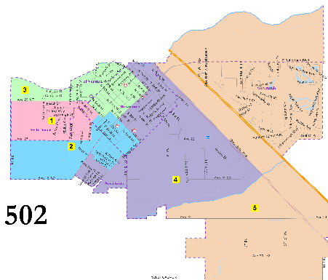



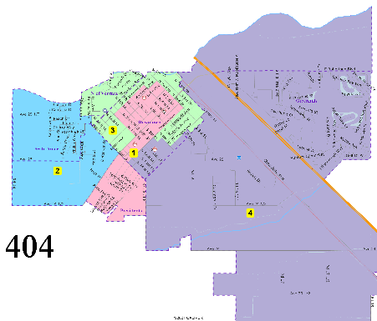
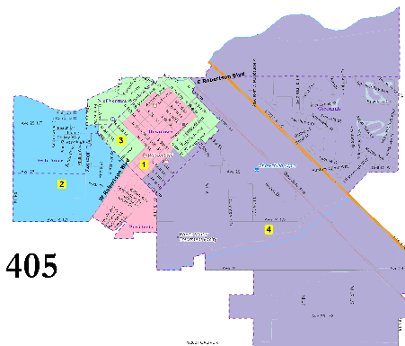
Public Hearing & Discussion
June 3, 2024

